Slide 1
Radiometric Calibration of Current and Future Ocean Color Satellite Sensors
R. Foster, S. Hlaing, A. Gilerson, S. Ahmed
CoRP Science Symposium
September 9-10, 2014
Robert Foster, ME, LEED AP
Optical Remote Sensing Laboratory
The City College of New York

Slide 2
Outline
Introduction & Motivation
Datasets & Methodology
Results
Summary & Conclusion

Slide 3
Introduction & Motivation
This work is focused on coastal areas. Why?
More than half of the world’s population exists in coastal regions.
Harmful Algal Blooms cause 10% of all foodborne disease outbreaks (toxins from algal blooms do not cook out of food).
Economic activity associated with the ocean added $222 billion to the US economy in 2009.
Vacationers visiting coastal regions spend $44 billion annually.
Much of the radiometric work associated with the open ocean has been figured out already.
Facts taken from the Natural Resources Defense Council website http://www.nrdc.org/water/oceans/ttw/health-economic.asp

Slide 4
Introduction & Motivation
Remote Sensing of Coastal Waters is extremely challenging.
Current Ocean Color (OC) sensors include MODIS-Aqua, and the recently launched VIIRS.
Traditionally, OC sensors have relied on robust in-orbit radiometric calibration and validation procedures based on the MOBY buoy.
The final adjustment made to the sensor’s TOA measurements, based on surface measurements or climatology model, is known as a vicarious calibration procedure.

Slide 5
Introduction & Motivation
There are two basic kinds of vicarious calibration.
The first one is usually referred to as the (system) vicarious calibration procedure. In that procedure, calibration coefficients are obtained by forcing satellite-derived water-leaving radiances to agree with in-situ ones.
The second procedure, which is referred to as a radiometric vicarious calibration, consists of simulating the TOA signal that the sensor should measure under certain conditions, and to compare it to the measured signal.

Slide 6
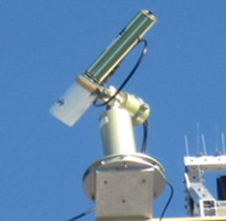
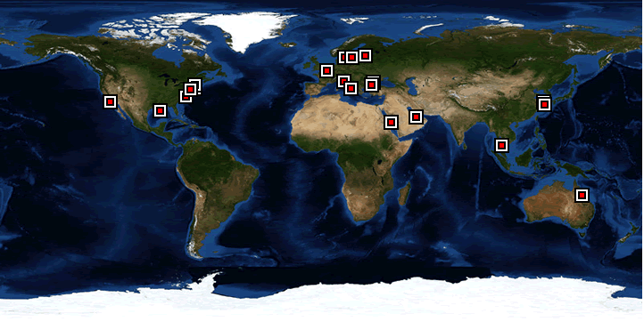
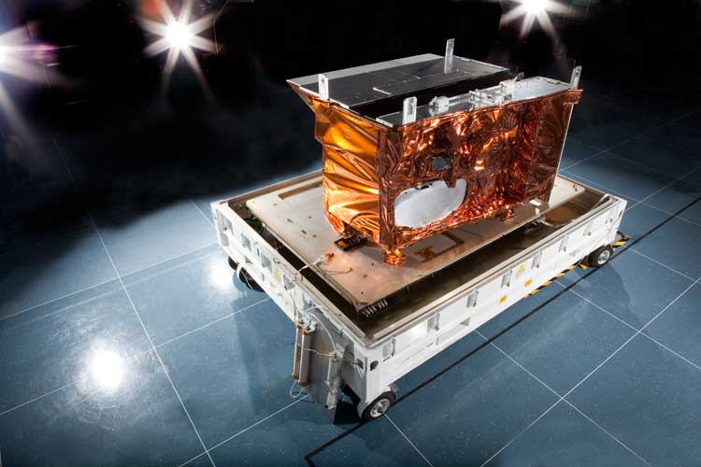
Datasets
AERONET-OC
Aerosol optical thickness (τ_{aot})
Single Scattering Albedo (SSA)
Scattering phase functions
Water Absorption and Scattering coefficients (derived using a Quasi Analytical Algorithm)
National Weather Service
Atmospheric pressure
Wind Speed
NASA Ozone Monitoring Instrument (OMI)
Molecular absorption in the atmosphere
NASA MODIS-Aqua
Top of Atmosphere Radiance L_{t}(λ)
NASA VIIRS
Top of Atmosphere Radiance L_{t}(λ)

Slide 7
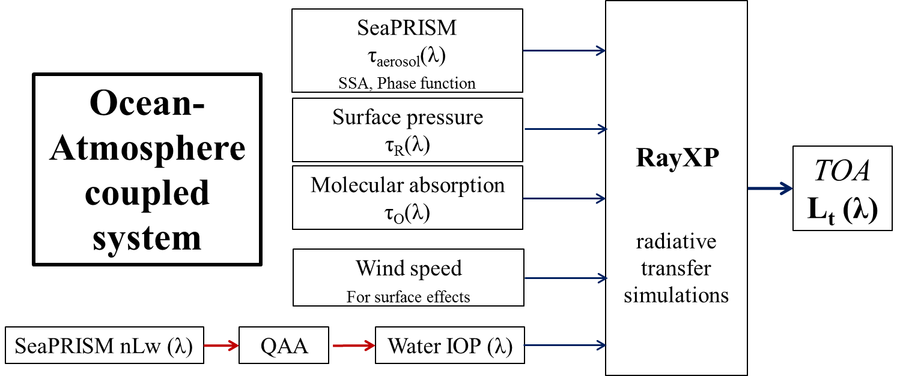
Methodology
Satellite
L_{t}(λ)
Simulated Top of Atmosphere (TOA) measurements are directly comparable to satellite observations.
This decouples the atmospheric correction procedure from the matchup – a major source of uncertainty.

Slide 8
AERONET-OC sites
WaveCIS
LISCO
Time series of nLw(551nm), in mW/cm²/μm/sr
WaveCIS
particulate backscattering coefficient at 551 nm is usually around 0.01 m^{–1}.
seasonal average of the total absorption of water body is equal to 0.31 m^{–1} at 442 nm, of which ~0.15 m⁻¹ is attributed to CDOM.
LISCO
the particulate backscattering coefficient at 551 nm ranges from 0.01 to 0.03 m^{–1},
the total absorption coefficient at 443 nm varies from 0.38 to 1.2 m^{–1};
the absorption due to CDOM at 443 nm is typically close to 0.4 m^{–1} and can be as high as 1 m^{–1}.
Three-year (2011–2013) average Angstrom exponent γ (443, 870) of LISCO is 1.76, whereas it is 1.23 for WaveCIS. This implies that the aerosols over WaveCIS are dominated by coarse particles whereas the LISCO site has notable contributions from fine aerosol particles.

Slide 9
Matchup comparisons between the simulated and VIIRS L_{t} (λ)
WaveCIS
LISCO
Excellent correlations with the overall R values close to 1 are observed for both sites.
Spectral variation ranges of simulated and VIIRS L_{t} (λ) are the same.
Regression lines for the comparisons are very close to 1:1 diagonals: simulated L_{t} (λ) data are spectrally and magnitude wise consistent with those of measured (i.e. VIIRS).

Slide 10
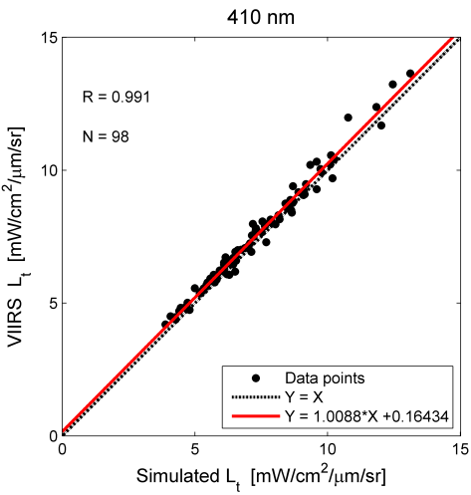
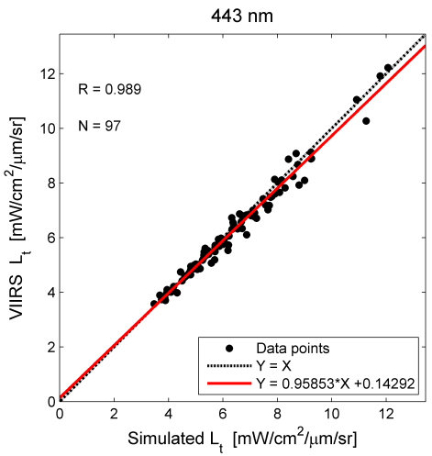
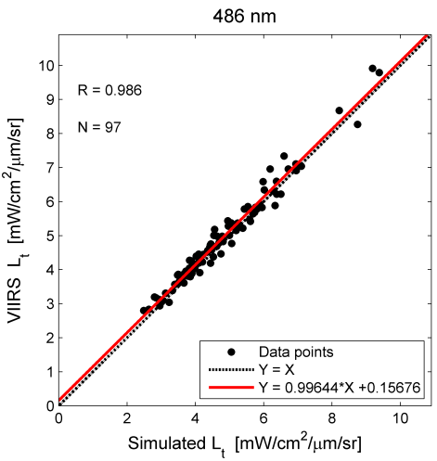
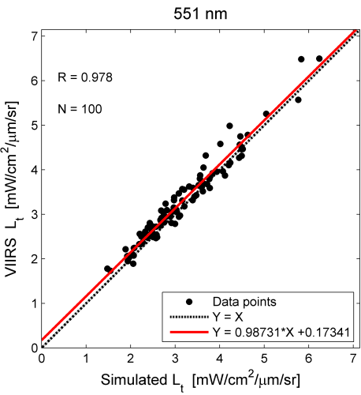
Matchup comparisons between the simulated and VIIRS L_{t}(λ) (Blue & Green parts of the spectrum)
Excellent correlations with the overall R values close to 1 are observed at every wavelengths.
Variation ranges of simulated and VIIRS L_{t} are the same.
Regression lines for the comparisons are very close to 1:1 diagonals.
These observations underscore that the simulated dataset is suitable for making assessments of the radiometric accuracy and stability of the Satellite Ocean Color sensors in blue and green wavelengths.

Slide 11
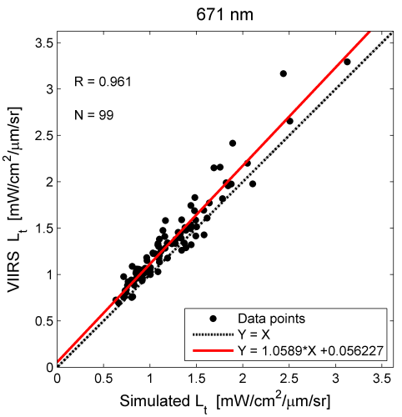
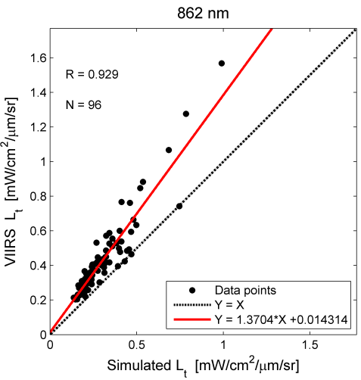
Matchup comparisons between the simulated and VIIRS L_{t}(λ) at each wavelength (Red & NIR parts of the spectrum)
Different story emerges for Red and NIR wavelengths.
Regression lines for the comparisons significantly deviate from 1:1 diagonals.
Simulated data underestimate ~10% & ~30% respectively at 671 and 862 nm wavelengths.
Excellent correlations are also observed at both wavelengths.
This observed discrepancy between the simulated and VIIRS data will be further scrutinized in next few slides.

Slide 12
Matchup comparisons between the simulated and MODIS L_{t} (λ) at WaveCIS
Unlike VIIRS, the uncertainties between MODIS and simulated L_{t} are higher at every wavelength.
Only modest correlation is achieved for the comparisons at 551, 667 & 869 nm (R values are 0.85, 0.78 & 0.75 respectively).
This can be largely explained by the MODIS’s lower 1 km nadir nominal resolution

Slide 13
Derivation of the radiometric vicarious calibration gain factors
The g_{c} values derived for both VIIRS MODIS for blue and green wavelengths are within typical vicarious adjustment range.
Such large deviations also exist for MODIS in NIR channels.
simulated
satellite

Slide 14
Similar Results by a Third Party
Sensor | SeaWiFS | MODIS | MODIS | VIIRS | VIIRS
Site | AAOT* | AAOT* | WaveCIS | WaveCIS | LISCO
671(667) nm channels | 0.90546 | 0.9154 | 0.9693 | 0.8917 | 0.9123
745 (748) nm channels | 0.851 | 0.875 | 0.8444 | 0.854 | 0.868
862 (869) nm channels | 0.83 | 0.839 | 0.834 | 0.706 | 0.700
In the vicarious calibration study by Melin and Zibordi* for MODIS and SeaWiFS sensors based on the data from the AAOT AERONET-OC site but with a different methodology, similar trend is observed in Red and NIR.
Although correlations between the simulated and satellite TOA L_{t} at the red and NIR channels are high (R ≥ 0.93 for those channels), validities of the resulting g_{c} values are inconclusive at the moment, further separate study should be granted to resolve the issues.
*F. Mélin and G. Zibordi, "Vicarious calibration of satellite ocean color sensors at two coastal sites," Appl. Opt. 49, 798-810 (2010).

Slide 15
Summary
Coastal locations of AERONET-OC site make this particularly suited for improving coastal satellite retrievals.
Cross-site uncertainty is well below or around the 0.5% in blue and green part of the spectrum.
Including more AERONET sites in the gain derivation process can help reduce the overall uncertainty.
The derivations are intended only as capability demonstration and should not be regarded as the final results.
It can be expected that in an ideal case, as long as the sensor calibration improves, both the MOBY based system vicarious approach and this RT based approach should converge providing high quality atmospheric and oceanic data in open ocean and coastal areas with the current or slightly adjusted atmospheric correction.
For More Information:
S. Hlaing, A. Gilerson, R. Foster, M. Wang, R. Arnone, S. Ahmed, “A Radiometric Approach for Calibration of Current and Future Ocean Color Satellite Sensors ,” Optics Express. Currently in press.

Slide 16
Thank you!

Slide 17
Appendix

Slide 18
Satellite Data Filtering and Processing Procedures
The VIIRS and MODIS TOA L_{t} (λ) used for comparisons with the simulation results are all extracted from a small region (3×3 pixel box) centered at the site locations.
Average value of the L_{t} (λ) of 3×3 pixel box, except the center one, is evaluated against simulated TOA L_{t} (λ). The exclusion of the central pixel is intended to minimize the potential uncertainty resulting from the platform effects due to the high albedo of the platform structure.
We also exclude the satellite L_{t} (λ) data with high spatial variability from the analysis, using the relative standard deviation (coefficient of variation), calculated as σ_{rel} = σ/µ where σ and µ are the standard deviation and mean, respectively. σ_{rel} is set to 0.2.
Level 2 quality flag conditions are acquired through the standard NASA processing scheme: land, cloud, stray light, bad navigation quality, both high and moderate glint, and high sensor viewing and/or solar zenith angles.
Data points with the sensor–sun relative azimuth angle less than 40° (i.e., TOA radiance measurements made close to the direct solar path) are also excluded from the analysis.
In addition, at least 50% of the pixels in the region of interest must satisfy all quality flag conditions in order to qualify for the match-up comparisons with the simulated TOA Lt (λ) and to be used in the derivation of radiometric vicarious gain factors.

Slide 19
Statistical Filtering Procedure
A statistical match-up comparison filtering procedure is further applied.
relative percentage difference of the i^{th} match-up
x_{i} and y_{i} stand for the i^{th} individual satellite and simulated match-up TOA radiance data points, respectively.
Then the initial average (μ_{RPD}) and standard deviation (σ_{RPD}) of the all resulting RPD_{i} between the two data being compared are calculated.
After that any match-ups with the RPD_{i} values outside the μ_{RPD} ± ∆ σ_{RPD} range are excluded from further analysis.
This procedure is applied just to ensure that the values of the statistical parameters thus obtained are not skewed by one or a very few extreme cases whose statistics are entirely out of range of the majority of cases.
∆ is set to 2 for all matchup comparison analysis and 1 for the radiometric vicarious gain derivation.

Slide 20
In-situ & Satellite Data
In-situ data
All input AERONET-OC data used in this study are level 1.5 data.
AERONET-OC data to the RT simulations are selected from the measurements made within a ±2h time window of the satellite overpass time of the locations of the sites.
SeaPRISM’s center wavelengths (413, 442, 491, 551, 667 & 870 nm) are slightly different from those of VIIRS’s (410, 443, 486, 551, 671 & 862). Therefore aerosol optical thickness data (τ_{aot}) at exact VIIRS center wavelengths are obtained by interpolation using Angstrom exponent (γ) at corresponding wavelengths.
Satellite data
NASA VIIRS data
Pseudo Level 1 VIIRS images of the LISCO and WaveCIS locations have been obtained for two years (January 2012 to December 2013) period from NASA OBPG ocean color website.
Then, SeaDAS software version 7.0.2 package in order to generate the fully calibrated and geo-located level 2 data.
IDPS VIIRS data
VIIRS SDR data of IDPS processing is obtained from NOAA NESDIS. They are completely calibrated and geo-located at the SDR level & do not require additional processing.
MODIS data
MODIS level 1 collection 6 images are acquired from the NASA Level 1 and Atmosphere Distribution System (LAADS). These data are also fully calibrated and geo-located.
Note: Comparison between the NASA and IDPS VIIRS L_{t} data exhibits almost perfect correlation at every wavelength but slightly time dependent discrepancy (1 – 3%) in terms of magnitude. For consistency purpose, we used only the NASA VIIRS data for all analyses in this study.

