Slide 1
Retrieving river ice parameters for ice jam prediction via MODIS on the lower Susquehanna River
NOAA/NESDIS CORP Science Symposium
10th September 2014 @ CCNY, CUNY
Simon Kraatz, PhD. Student
Advisors: Dr. N. Devineni, Dr. R. Khanbilvardi

Slide 2
Organization
Introduction
Remote sensing of river ice
Retrieval approach
Results
Conclusion

Slide 3
What’s an ice jam?
An ice jam is …
“… a stationary accumulation of ice or frazil that restricts flow”
- IAHR
Chenango River @ Chenango Bridge, NY.
March 4, 2014. Source: www.weather.gov

Slide 4
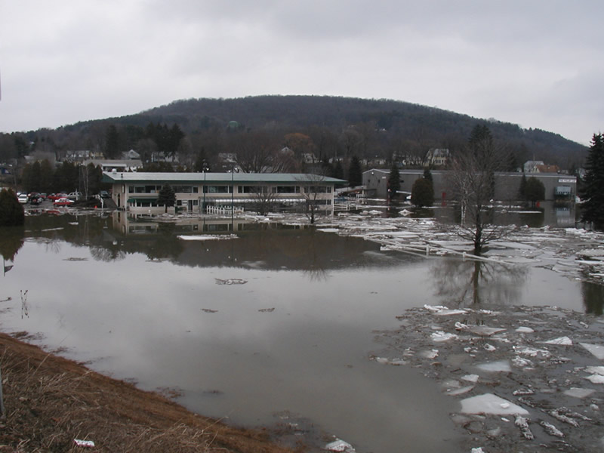
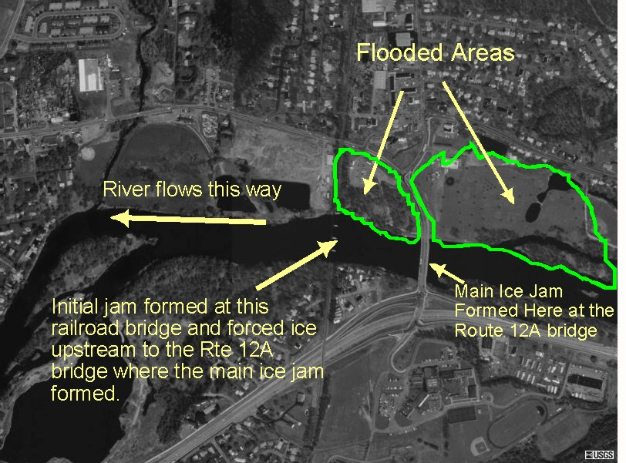
Impacts
Damages infrastructure via
Flooding
Moving debris
Jams can go from benign to serious over short time scales
Difficult to predict which jams are problematic
March 4, 2014. Source: www.weather.gov

Slide 5
Overview
Model for ice jam prediction
Statistical model (GLM, MCMC …)
Satellite river ice observation
Automated algorithm, daily
Prediction
Needs
Long time series
Frequent observations
Appropriate spatial resolution for target region (≤500 m)
Open data access

Slide 6
Possible input parameters
Dynamic
Discharge
Temperature
Ice presence
Quantity (NDSI if CF)
Age
Thickness
Static
River sinuosity
Slope changes
Constrictions and obstructions

Slide 7
MODIS
MODIS
Moderate spatial resolution
Up to 250 m, (2 bands)
Revisit time ~ 1 day
Open access
Long time record
Terra since 2000
Aqua since 2002
Poor at seeing through weather
MOD29 masks land and inland water bodies at 1 km
Band | Range nm
1 | 620-670
2 | 841-876
3 | 459-479
4 | 545-565
5 | 1230-1250
6 | 1628-1652
7 | 2105-2155
MODIS solar channels. Source: Vermote et al. (2011).

Slide 8
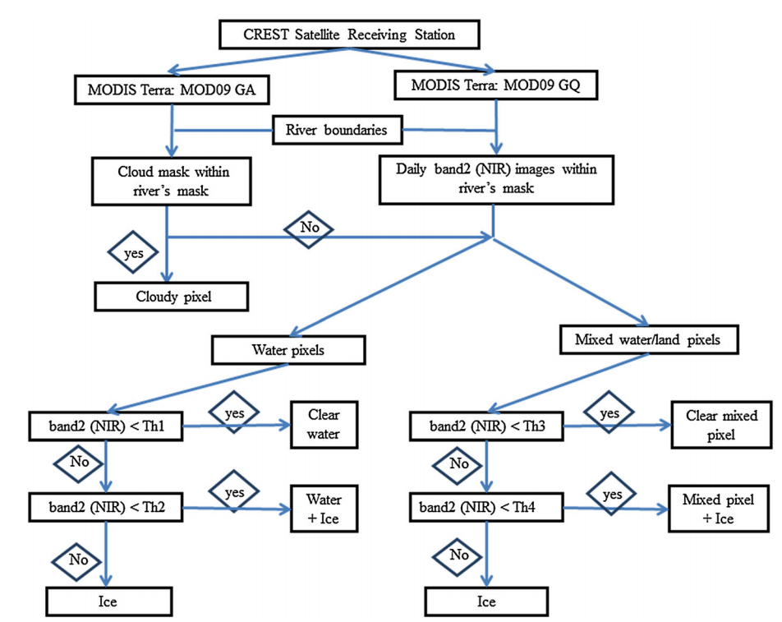
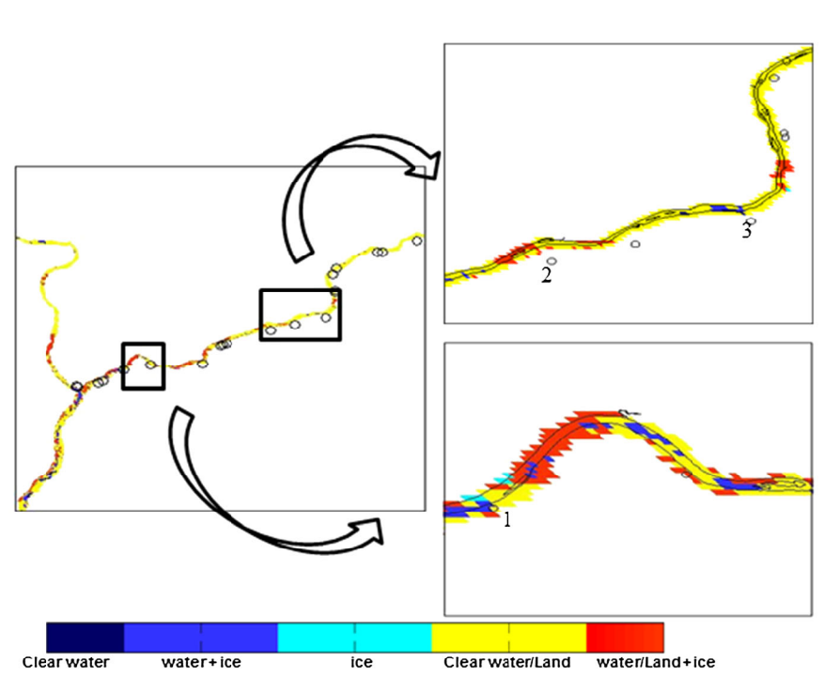
CRIOS (Terra)
CRIOS
Spatial resolution of 250 m
bands (1), (2)
Data 2003-2012 (Nov-Mar)
Start and end date varies year to year
Susquehanna River
Classified
Source: Chaouch et al. , 2012.

Slide 9
CRIOS analysis (Jan-Mar, 2003-2012)
Results
Overall cloud fraction (CF): 0.67
Low CF, ~every 4th day
Little ice detected when CF > 0.2
Statistics
Mean | 0.67
Median | 0.97
Mode | 1.00
30 km

Slide 10
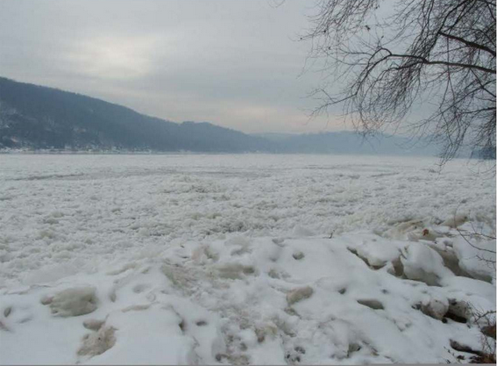
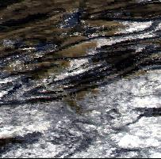
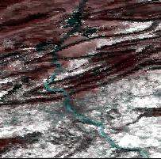
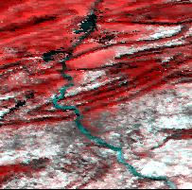
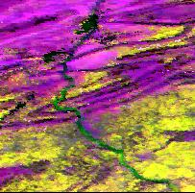
River ice test (1/25/14, @ 500 m)
Band | Range nm
1 | 620-670
2 | 841-876
3 | 459-479
4 | 545-565
5 | 1230-1250
6 | 1628-1652
7 | 2105-2155
Ice jam @ Marietta, 1/23/2014
R (5, 1240 nm) – SNW/CLD
G (4, 550 nm) – ICE/SNW/CLD
B (7, 2130 nm) – CLD
MODIS solar channels. Source: Vermote et al. (2011).
MYD09A1, fc (211)
MYD09A1, fc (511)
MYD09A1, fc (547)
MYD09A1, tc (143)
Susquehanna River at Marietta, PA, 02/03/14.
Source: CRREL IJDB.

Slide 11
Multispectral river ice detection
Source: USGS PP-1386-A. (Ch. A-2, Fig. 77).

Slide 12
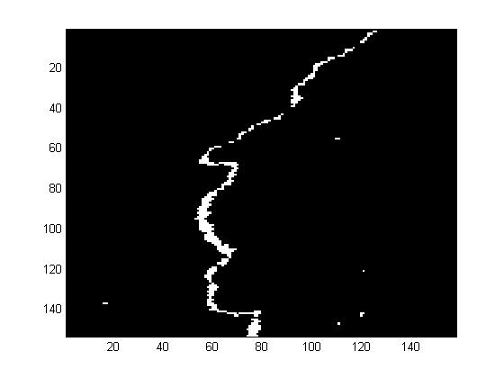
Data processing and visualization
Raw data (each band)
Subset
NaN’s
Offset and scale
Data ranges from -0.01 to 1.60, used for computation
Optional steps
Scale each band from 0 to 255
Resulting images can be misleading
Cloud mask (NN 1 km -> 500 m)
Output to GE (GeoTIFF/KML)
Make river mask
Scaled data, Aqua (547), 4/20/14.
Raw data, Aqua (547), 1/13/14.
Scaled data, Aqua (547), 1/13/14.
Scaled data, Aqua (547), 1/13/14.
Scaled data, Aqua (527), 6/7/09.
Scaled data, Aqua (527), 9/1/09.
Aqua (527) < 80, 9/1/09.
Raw data, Aqua (547), 4/20/14.

Slide 13
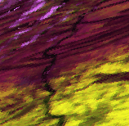
Winter time snapshots (Aqua/Cloud)

Slide 14
Results (Aqua)
If (5) and (7) < 20, count (4)
Ice start/end
Statistics
Mean | 6163
SD | 7630
Jam warning
Jam

Slide 15
Concluding remarks
Relationship between temperature and ice quantity as expected
Cloud presence is a problem
Retrieval despite cloud may help
CM has some problems over river
Next steps
Improve mask quality
classify, i.e. max likelihood
Retrieval despite cloud
Histogram informed threshold?
Generate NDSI, Ice Age
Merge Aqua/Terra data
Jam modeling
Transfer to AK

Slide 16
References
Vermote, E.F., Kotchenova, S.Y., 2008. MOD09 (Surface Reflectence) User’s Guide. http://modis-sr.ltdri.org/products/MOD09_UserGuide_v1_2.pdf
CRREL Ice Jam Database. http://icejams.crrel.usace.army.mil/
Chaouch, N., et al. "An automated algorithm for river ice monitoring over the Susquehanna River using the MODIS data." Hydrological Processes 28.1 (2012): 62-73.

