Slide 1


Assimilating merged remote sensing and ground based snowpack information for runoff simulation using hydrological models
Author: José A. Infante C.
Co-Authors: Prof. Khanbilvardi, Dr. Lakhankar, and Dr. Pradhanang

Slide 2
Outline
Introduction
Models Description
  SWAT (Land Surface Model)
  SNTHERM (Snowpack Model)
Preliminary results
  1st Experiment setup and results
  2nd Experiment setup and results
Conclusions
Current and Future work

Slide 3
Introduction
Hydrological modeling is a very important technique for several applications
  Assessment of: Water quality issues, Water availability, and floods.
Floods is an growing problem worldwide.
Around 60% of major flood events have occurred in Winter/Spring time
Some recent major flood events are:
Reds are in Winter/Spring time

Slide 4
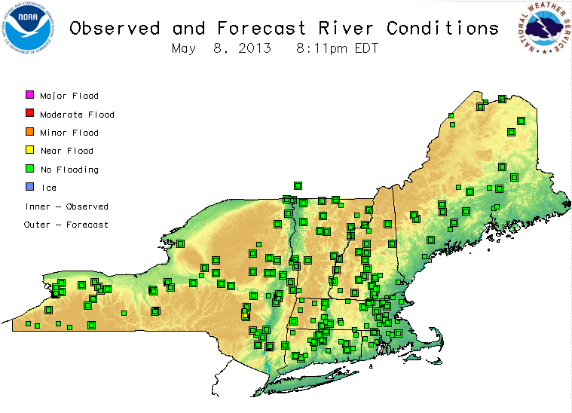
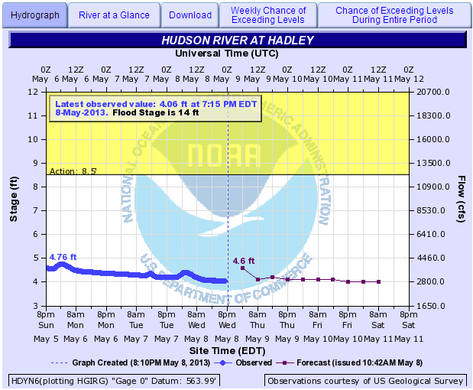
Introduction
Example: The Northeast River Forecast Center (NERFC)
  5 days observed
  5 days forecasted
http://www.erh.noaa.gov/nerfc/
This system has two problems:
  “Lump sump model”
  “Temperature driven snowmelt”

Slide 5
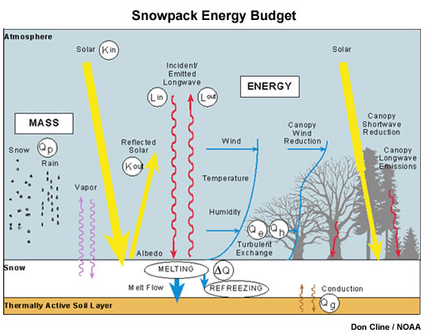
Introduction
Components of the energy balance equation for the snowpack
Extracted from: National Engineering Handbook. Part 630 – Hydrology. Ch. 11.
Source: www.meted.ucar.edu

Slide 6
Introduction
Improvements have to be made to both forcing data and models
This research will focus on improve hydrological simulation by:
  Using Distributed hydrological models
  Using spatially distributed weather forcing data
  Strengthening the snowpack simulation
Resulting in:
  Streamflow simulation with less uncertainty
  More accurate streamflow forecast

Slide 7
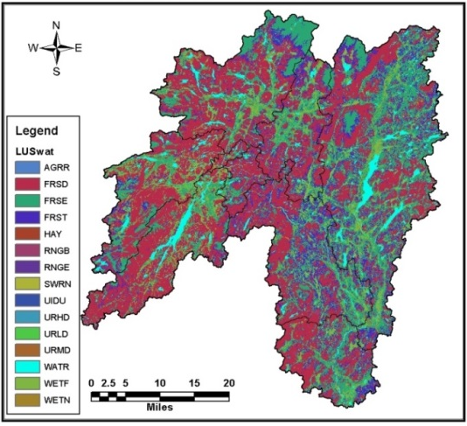
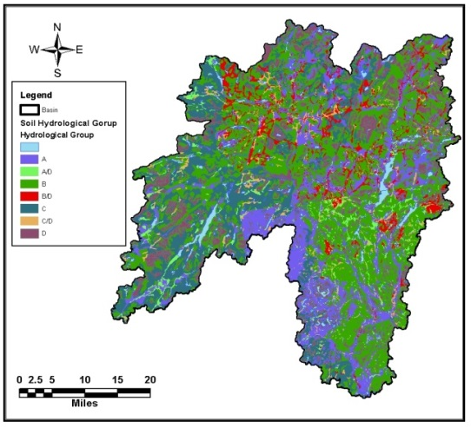
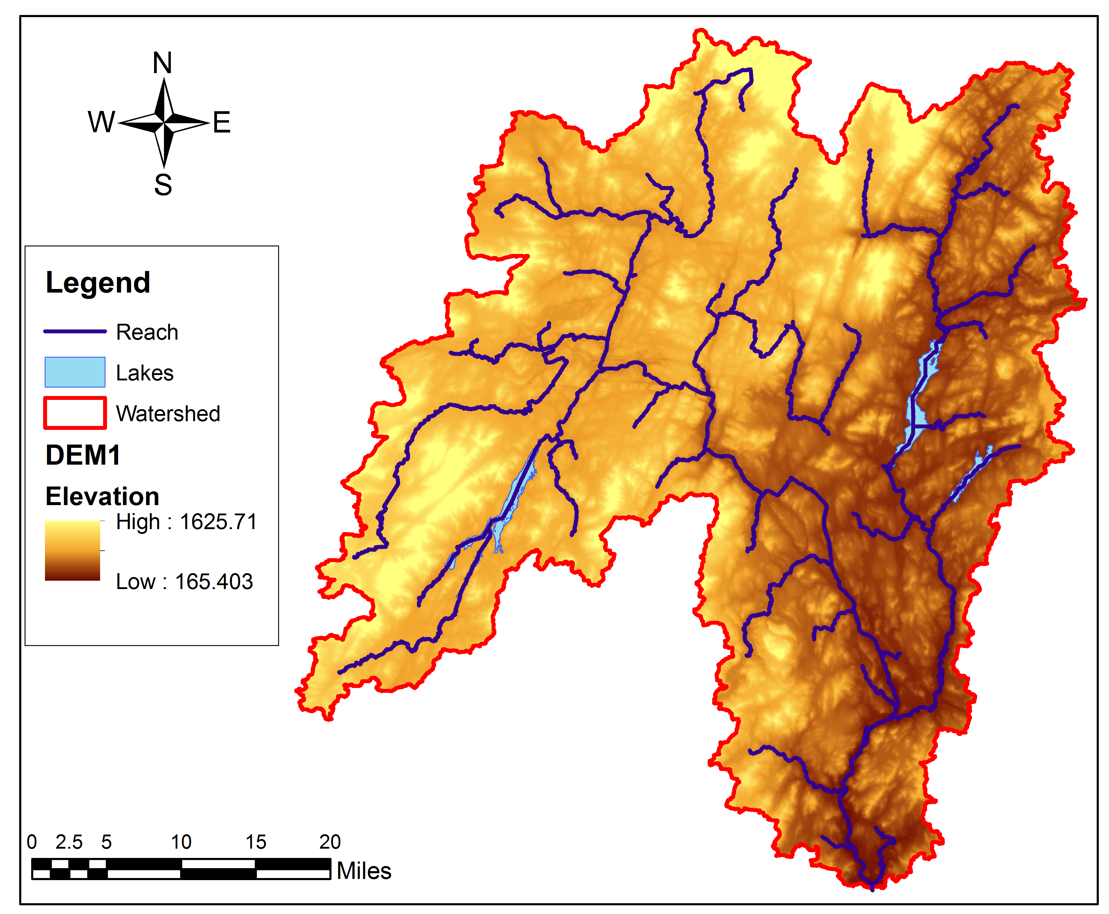
SWAT Model Description
SWAT MODEL:
  The Soil and Water Assessment Tool (SWAT) is a hydrological model capable of predicting runoff quantity and quality of a watershed given its main physical and hydrological properties.
This project attempts to improve the river discharge simulation by:
1- Considering spatial variation of Soil properties, Land Use and Morphology.

Slide 8
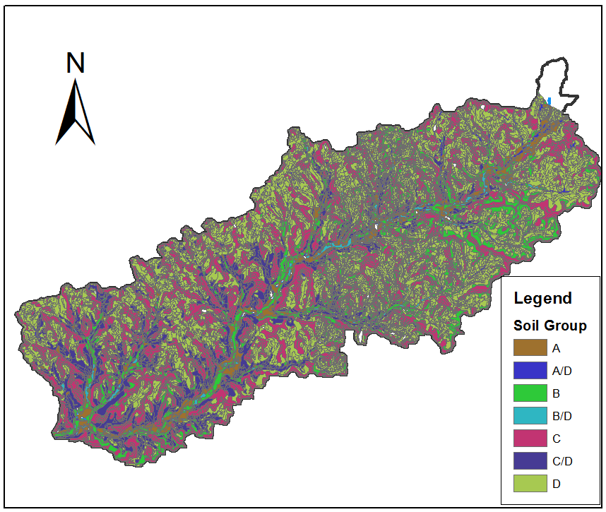
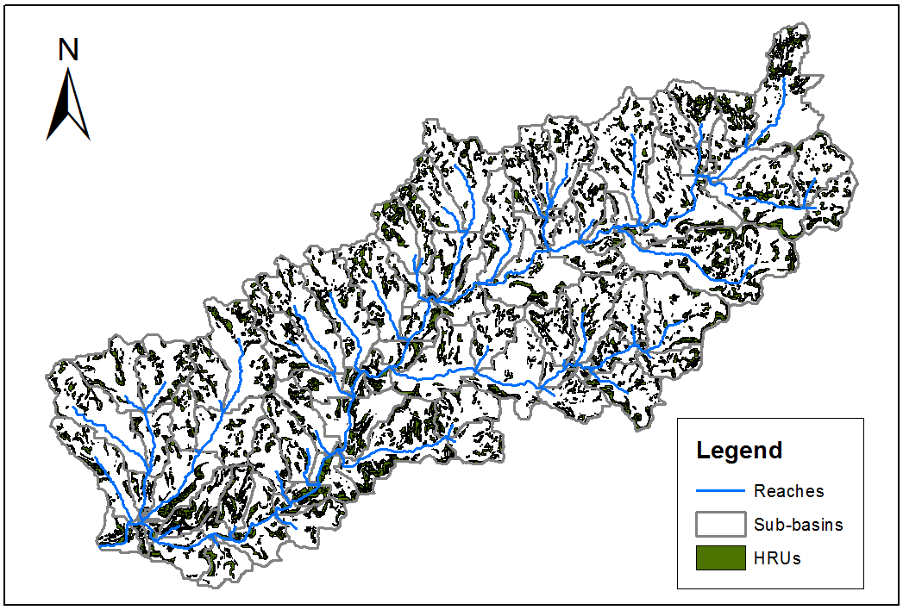
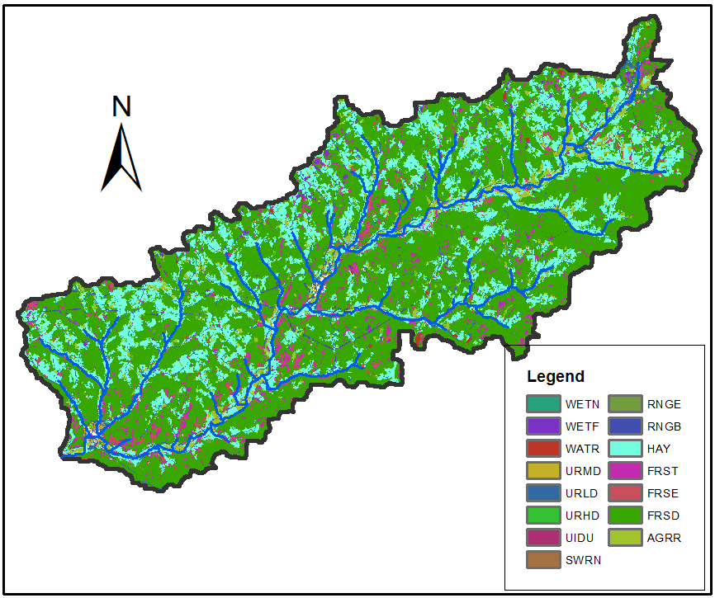
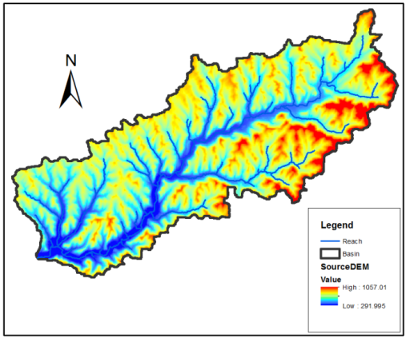
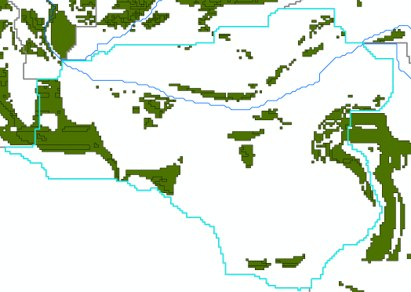
SWAT Model Description
Soil
Hydrological Response Units Map
Land
Slope

Slide 9
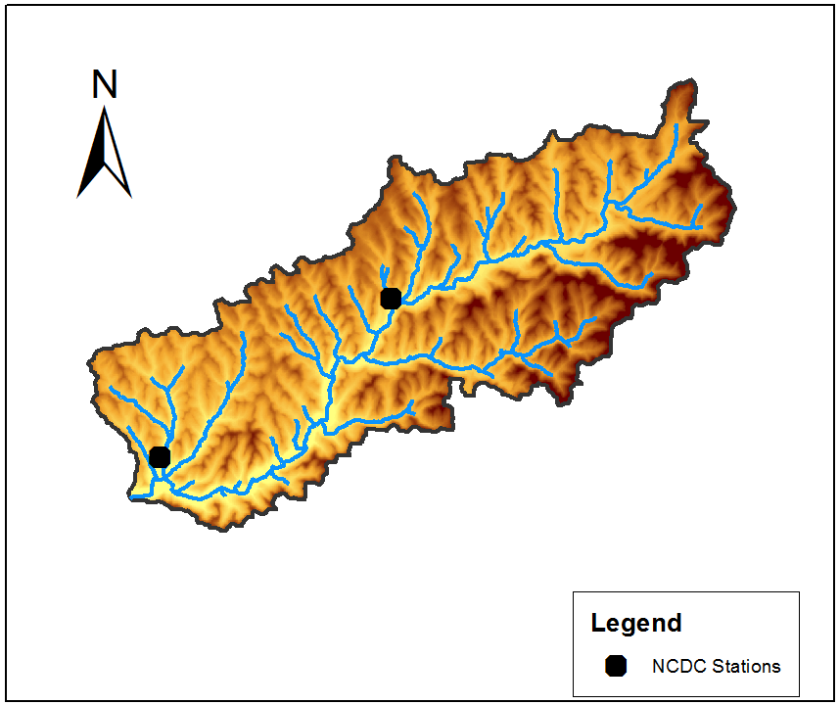
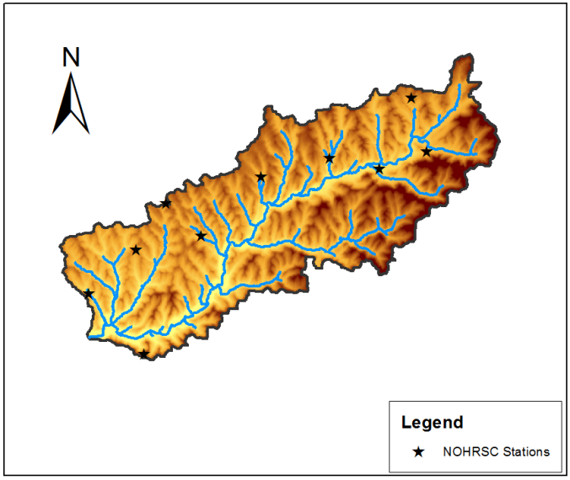
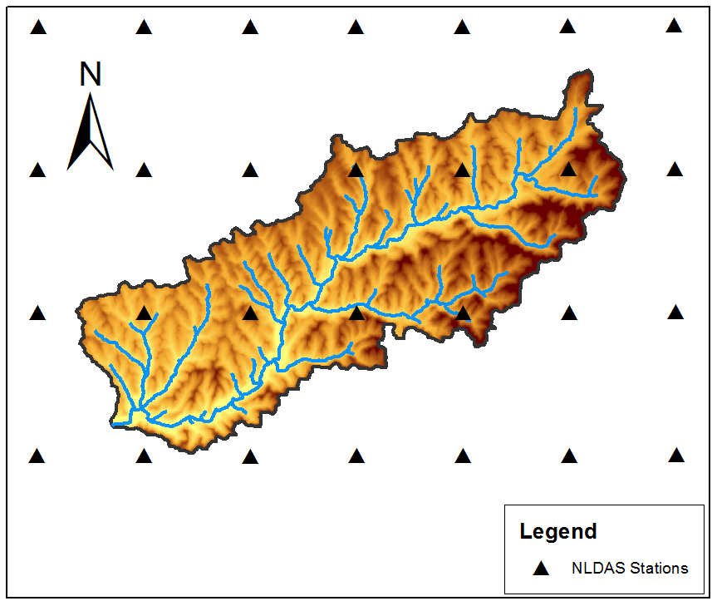
Datasets
From NCDC, NLDAS and NOHRSC
3 Types of datasets:
In-Situ Stations
Remote Sensed Data
Assimilation Systems
This project attempts to improve the river discharge simulation by:
2 - Considering merged in-situ and remote sensed weather data.

Slide 10
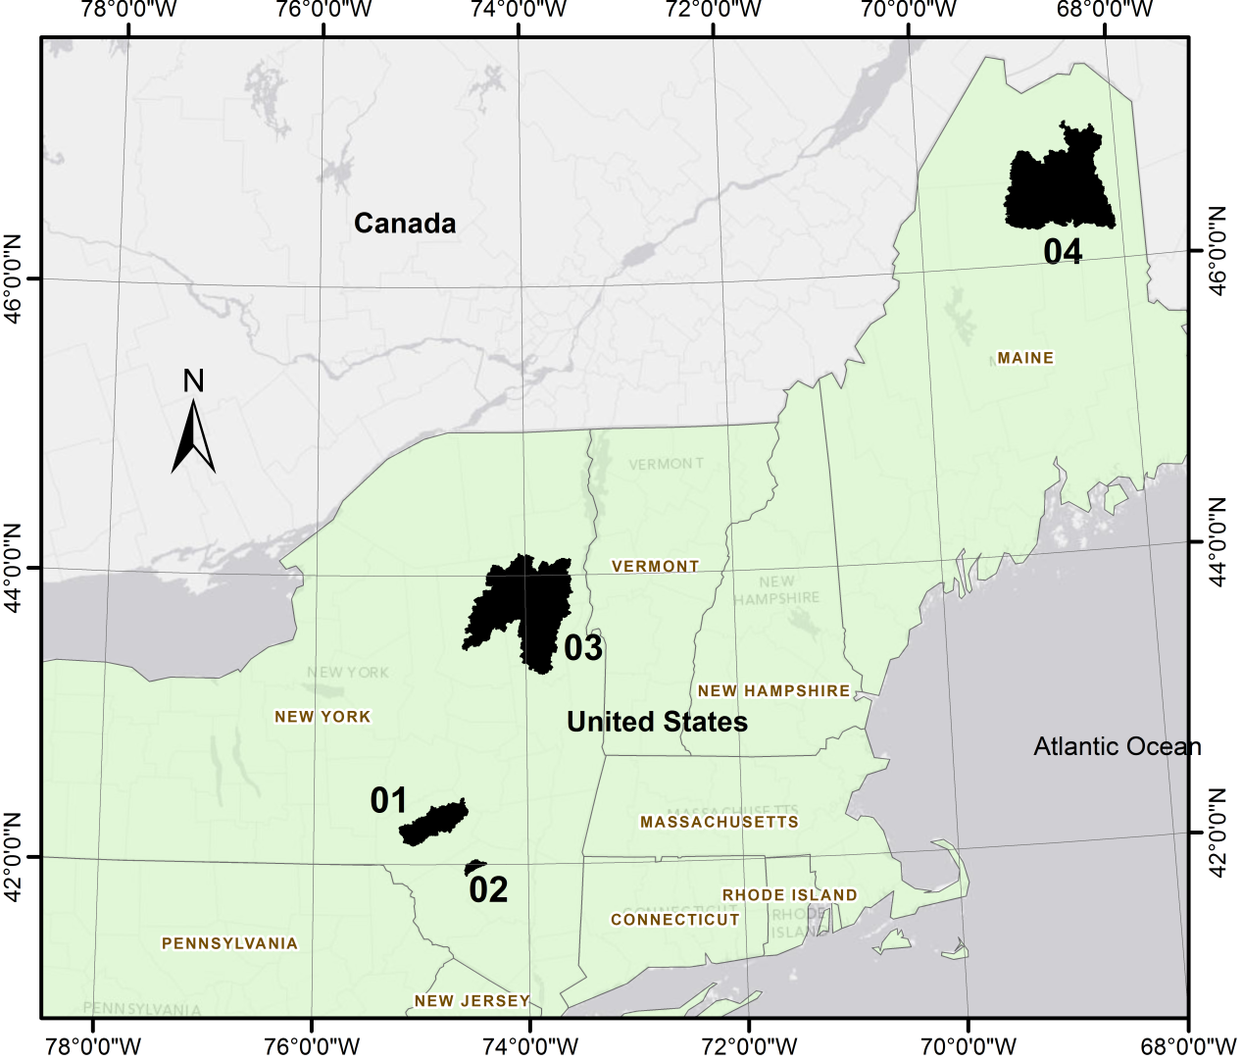
Study area

Slide 11
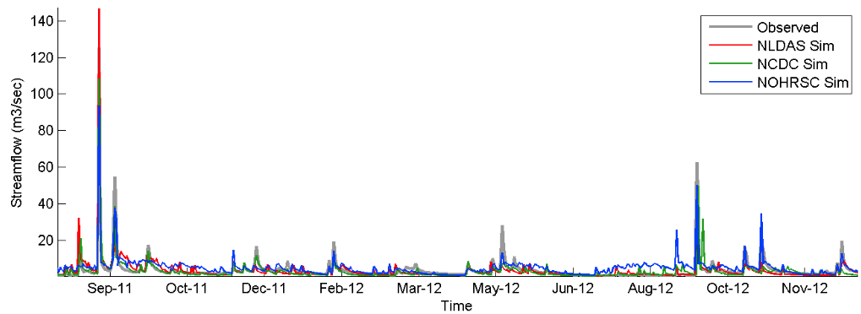
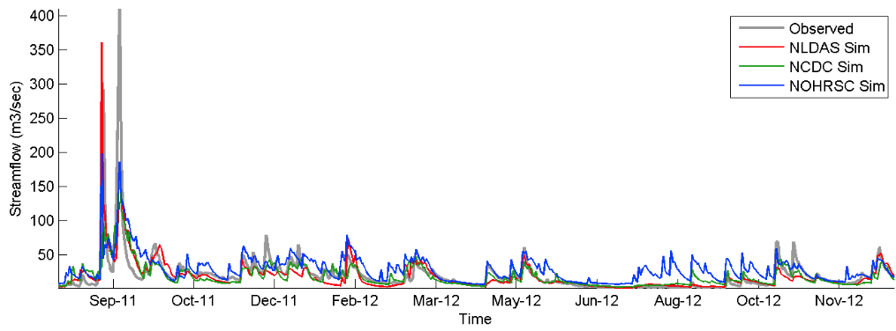
1st Experiment: simulations
Daily streamflow West Branch Neversink
Daily streamflow W. Branch Delaware (Cannonsville)

Slide 12
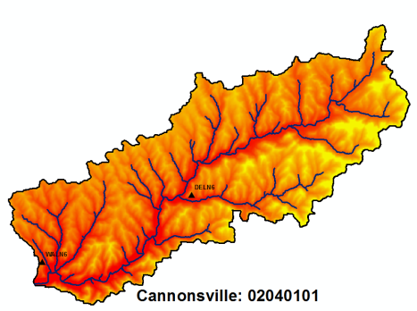
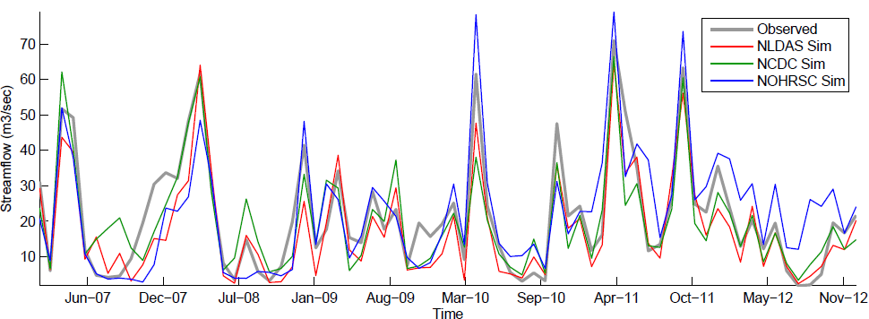
1st Experiment: Results
Average Monthly streamflow West Branch Delaware

Slide 13
1st Experiment: Results
Monthly simulations were very good.
Daily simulations were fair to good.
Best scenario was NLDAS.
Need to further assess:
  %Vol. Difference: >10% in some cases.
  T-test showed significant differences at daily scale.
  Seasonal differences (snow and no-snow).
Using combined datasets.
Further Calibration.
Improving snow simulation.

Slide 14
SNTHERM Model Description
SNTHERM MODEL:
  The Snow Thermal Model (SNTHERM) is a 1-dimensional model that analyzes the snowpack properties given the Weather Conditions of a particular area.
Snow Depth
Snow Water Equivalent
Snow Melt
Snowpack Temperature
Grain Size

Slide 15
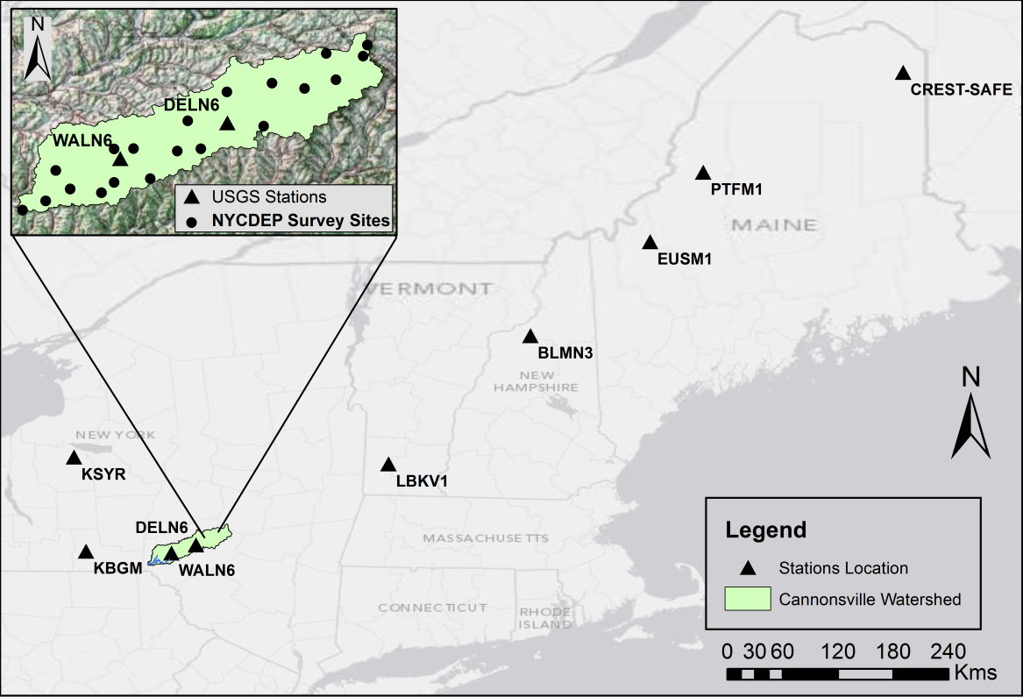
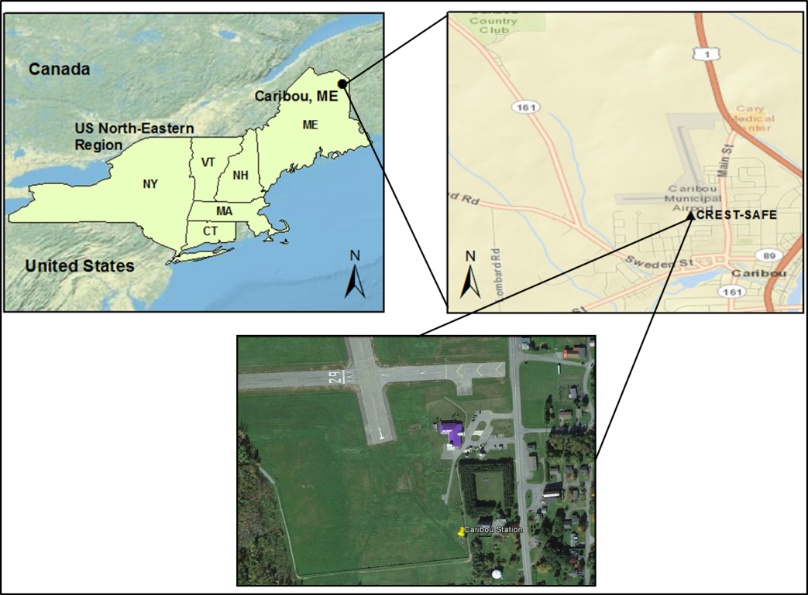
2nd Experiment: Datasets and study area
USDA’s SSURGO data for Soil properties.
USGS 30-meters DEM for Elevation, Slope, and Aspect
NLDAS dataset for forcing weather data.

Slide 16
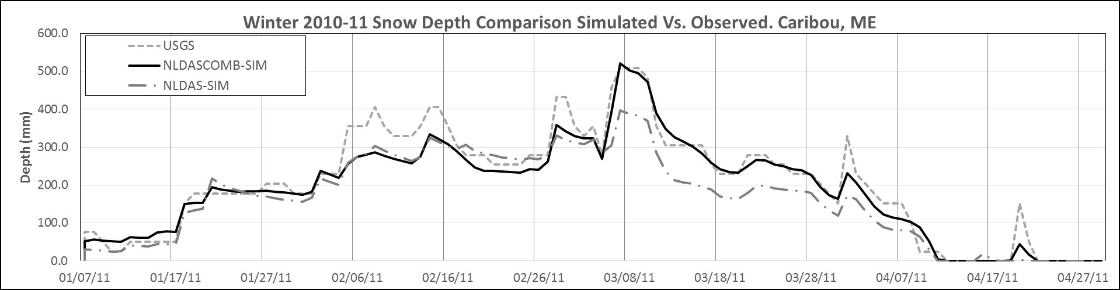
2nd Experiment: Snow simulation
SNTHERM MODEL:
  Calibration is still required:
    Genetic algorithm method for optimization.
    Parameters: Snow Viscosity, irreducible water content, and compaction limit
  Better data = better simulations
  Model is missing:
    Soil library (currently only clay and sand)
    Spatial Distribution
    Canopy effect

Slide 17
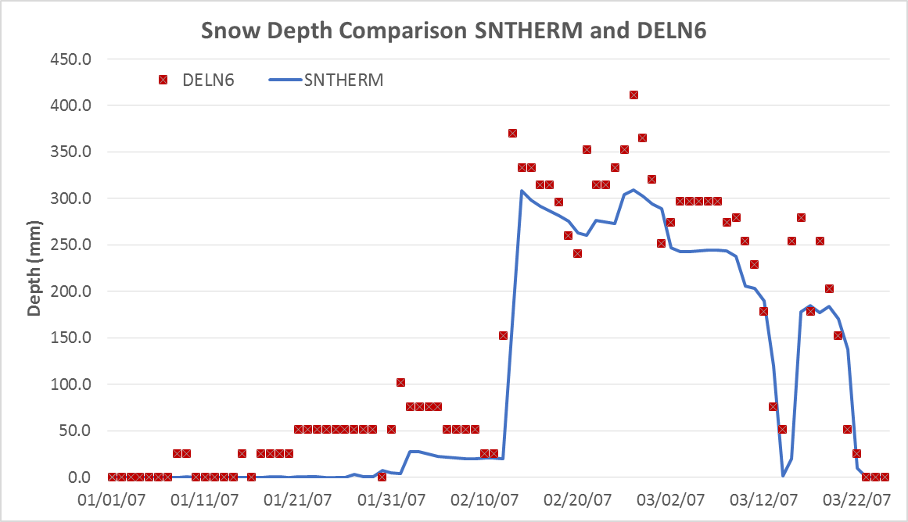
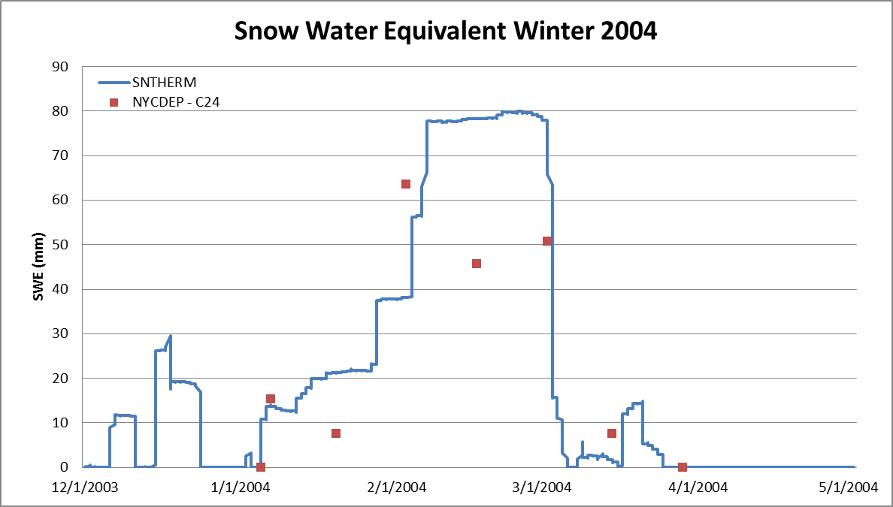
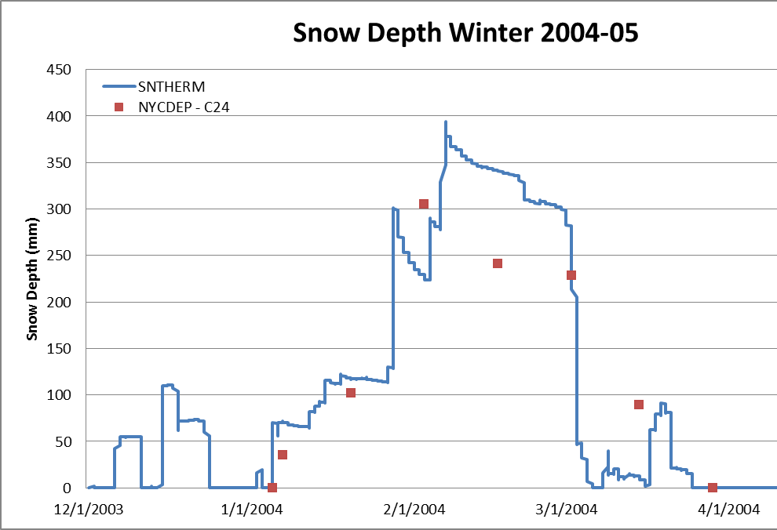
2nd Experiment: Watershed comparison

Slide 18
2nd Experiment: Regional comparison

Slide 19
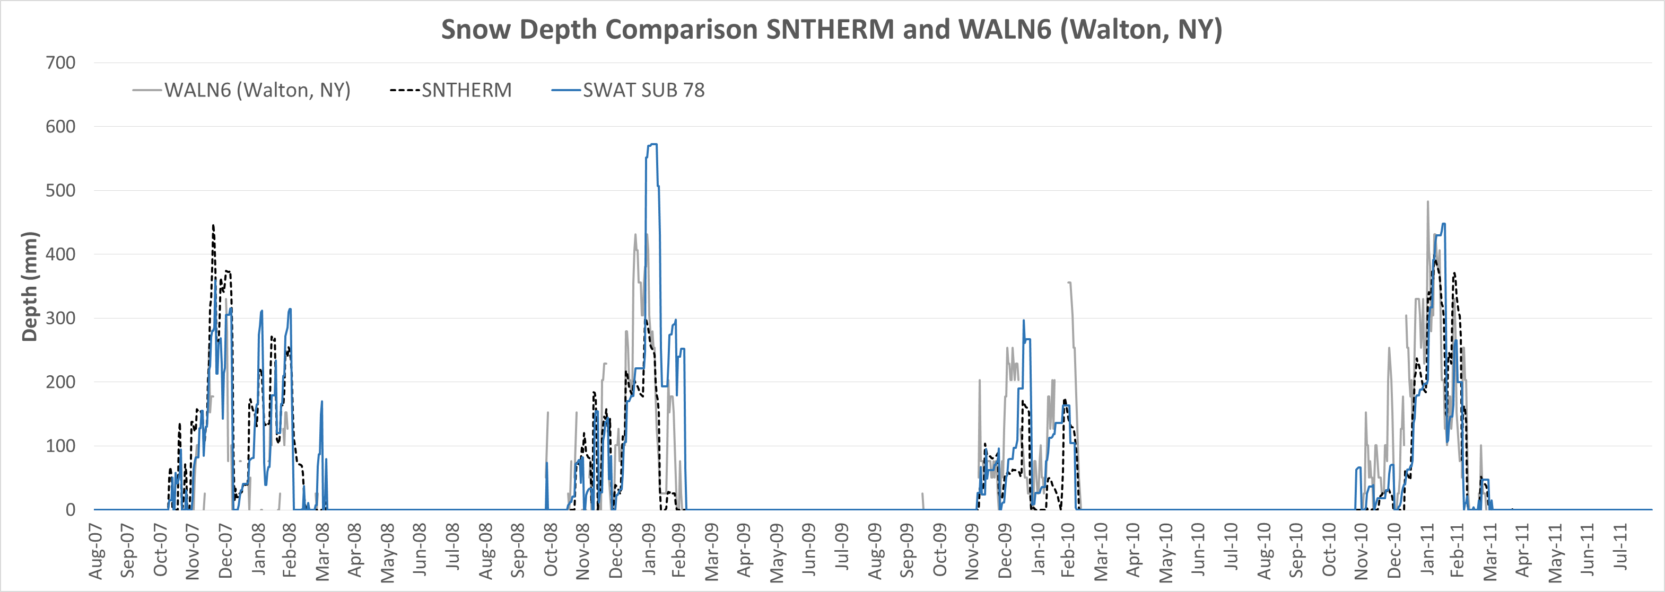
Models Comparison: SWAT vs SNTHERM

Slide 20
Conclusions
Improvements in the model’s accuracy can be accomplished using distributed meteorological data.
Adjustments to hydrological model can be made to achieve better results:
  SWAT model efficiency on winter-spring will be improved by incorporating the SNTHERM model.
The SNTHERM model showed a great versatility when simulating the snow depth time series for different scenarios.
Improvements needed by SNTHERM model:
  Include a complete Soil library
  Spatial Distribution of the model
  Canopy effect

Slide 21
Current and future work
A MatLab algorithm was used to run SNTHERM model at HRU level, based on SWAT inputs.
Soil Library was included in the SNTHERM model.
The canopy interception effects is being incorporated on SNTHERM.
SWAT model is going to be modified to read SNTHERM outputs as testing approach.
Sensitivity analysis for soil type in the SNTHERM model.

Slide 22
Thank you!
Any questions?
Author: José A. Infante C. (jinfant03@citymail.cuny.edu)
Advisors: Prof. Khanbilvardi, Dr. Lakhankar and Dr. Pradhanang

Slide 23
Publications and Conferences
Publications:
  J. Munoz, J. Infante, T. Lakhankar, R. Khanbilvardi, Peter Romanov, Nir Krakauer and Al Powell (2013) Synergistic Use of Remote Sensing for Snow Cover and Snow Water Equivalent Estimation, British Journal of Environment & Climate Change, vol. 3(4), pages 612-627.
  J. Infante et al. (2014). “Remote sensing and ground-based weather forcing data analysis for streamflow simulation”, submitted to Hydrological Processes.
  J. Infante et al. (2014). “Performance analysis between SNTHERM model using NLDAS data and ground-based snow measurements”, in preparation to be submitted.
  J. Infante et al. (2014). “Assimilating merged remote sensing and ground-based snowpack information for runoff simulation in hydrological models”. To be prepared on Sept 2014.
Conference presentations:
  J. Infante, T. Lakhankar, and R. Khanbilvardi (2013). Assimilating merged remote sensing and ground-based snowpack information for runoff simulation in hydrological models. Presented at 2013 AGU Fall Meeting. San Francisco, CA. December 9-13, 2013.
  J. Infante, T. Lakhankar , and R. Khanbilvardi (2013). Assimilating merged remote sensing and ground-based snowpack information for runoff simulation in hydrological models. Presented at Environmental Sustainability and Earth Systems Engineering Research Symposium (at HSPE 2013 conference). Indianapolis, IN. November 1-2, 2013.
  Benjamin Joseph, Jodi Siu and Mohammad Molla, J. Infante, T. Lakhankar , and R. Khanbilvardi (2011). Corroboration and Calibration of the SWAT and SNTHERM Hydrological Model of Watersheds, Oral presentation at CUNY Summer STEM Research Symposium, New York City, NY, August 2013.
  J. Infante, Lakhankar T., and R. Khanbilvardi (2012), Assimilating merged remote sensing and ground-based snowpack information for runoff simulation in hydrological models, presented at The 69th Annual Meeting of the Eastern Snow Conference Claryville, New York, June 5-7, 2012.

Slide 24
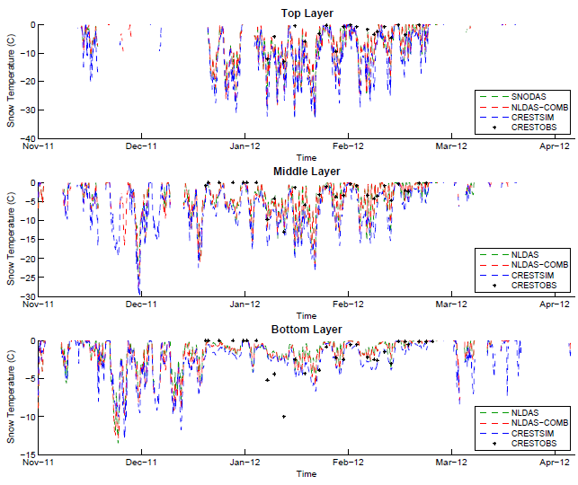
2nd Experiment: Point simulation
< 5 Cms
< 20 Cms

Slide 25
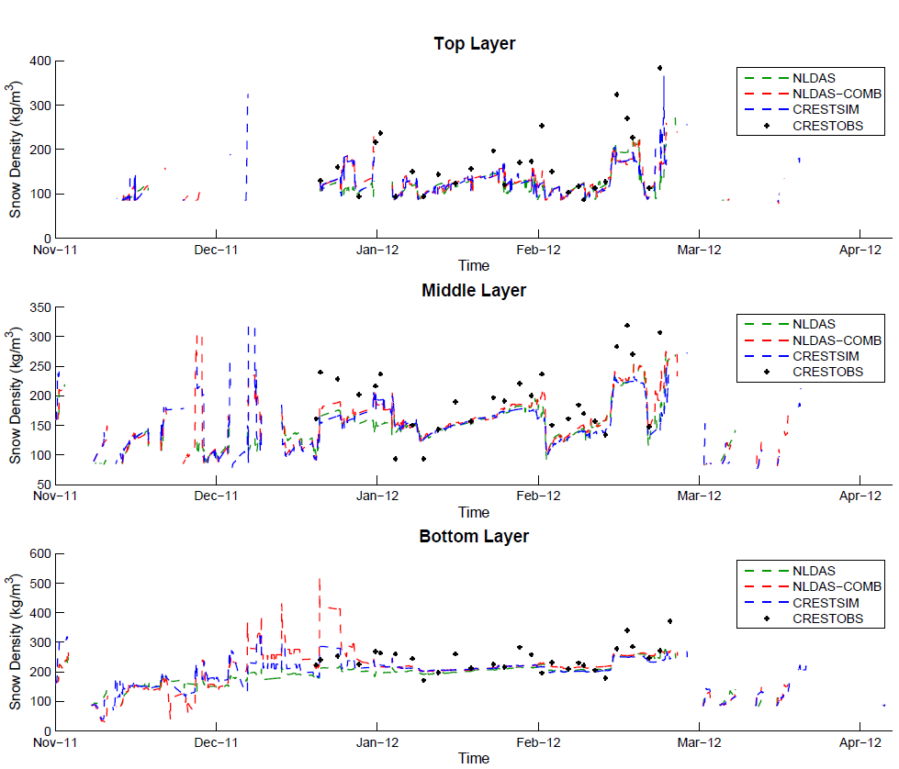
2nd Experiment: Point simulation
< 5 Cms
< 20 Cms

Slide 26
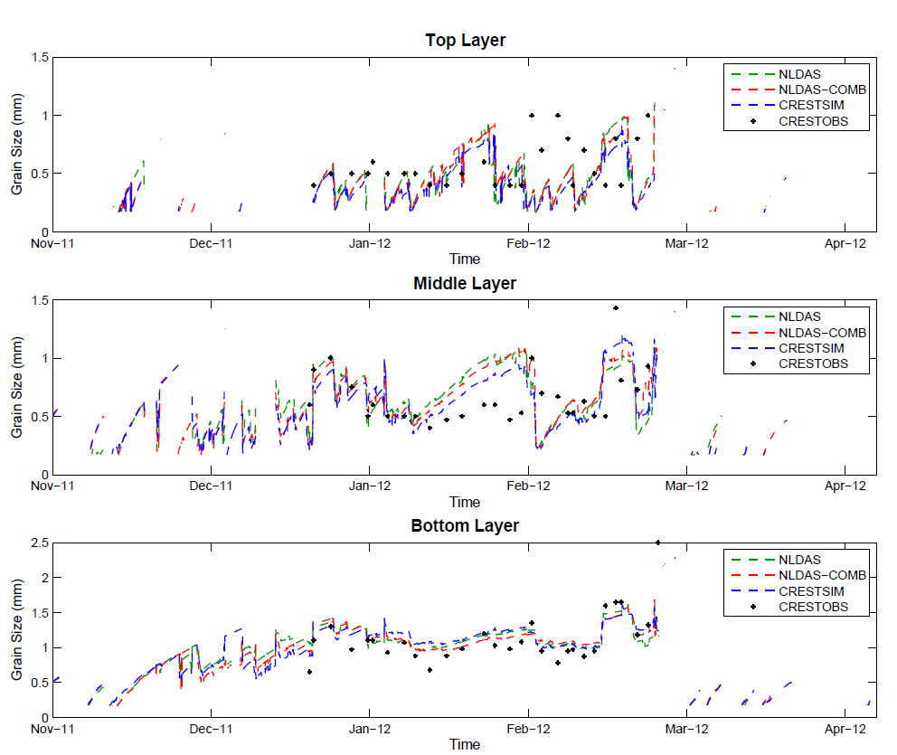
2nd Experiment: Point simulation
< 5 Cms
< 20 Cms

