Slide 1
On the Validation of Airborne Data and Atmospheric Modeling on Summer Temperature Gradients in Southern California
Pedro Sequera
Kyle McDonald
Daniel Comarazamy
Jorge Gonzalez
The City College of New York
NOAA/CREST
Steve Ladochy
California state university los Angeles/ NOAA/CREST
Notes:
NOAA EPP CREST Logos

Slide 2
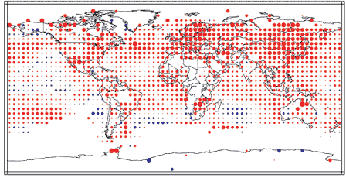
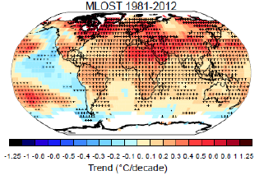
Motivation: Regional Cooling in a Warming World
Warming has been neither steady nor the same in different seasons or in different locations (IPCC 2007).
Some regions have been cooling in the last decades, especially in coastal mid-latitude and urban areas.
Among these regions are: the coasts of Peru and Chile, coastal California, Western Australia and South Africa.
The coasts of Peru, Chile and California have been cooling in the last four decades.
Annual Temperature Trends 1976-00 (IPCC 2001)
Trends in Global Mean Surface Temperature from NCDC MLOS

Slide 3
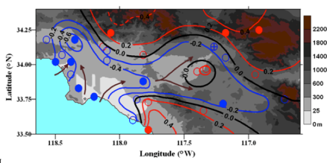
Motivation : Regional Cooling in a Warming World
Observed 1970-05 SUMMER Tmax (⁰C/decade) trends in SoCAB (left) & SFBA (right)(Lebassi et al. 2009)
Low-elevation coastal-cooling & high elevation & inland-warming.
Significance levels: solid circles >99% & open circles <90%.
Brown arrows indicate predominant summer flow patterns.
Effect extended inland towards the Central Valley.
SFBA more complex topography than SoCAB.
Hypothesis: cooling summer Tmax values in coastal California arise (as a posible “reverse-reaction”) from global warming of inland areas, which results in increased sea-breeze flow activity.

Slide 4
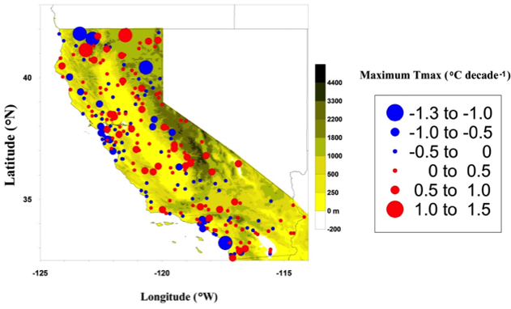
What is the spatial distribution of California Coastal-Cooling?
Daily Max 2-meter Temperature data for 241 California sites (NWS Coop) from 1970-2010.
Extreme monthly-average T_{max} values (maxT_{max}) trends calculated (⁰C/decade) using linear regression.
The maxT_{max} values were used as they are more closely related to energy brown outs, ozone episodes, and heat stress mortality. They also decrease at a faster rate in coastal-cooling areas than do monthly-mean T_{max} values (Ghebreegziabher 2013).
SFBA
SoCAB
San Luis
Obispo
San Diego
Generally cooling at low-elevation coastal locations and warming at both inland and high elevation sites.
A few cooling inland stations due to sea breeze penetration and long-term increased irrigation.
Two new coastal-cooling basins are seen.

Slide 5
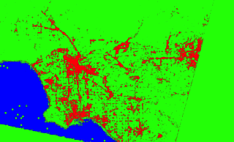
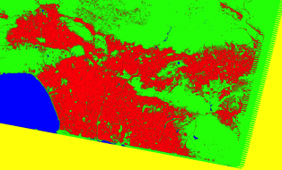
Changes in urbanization: Landsat LCLU-Classification
1972
2010
Land Cover Classification for the LA area using Landsat images.
Four classes: urban (red), non-urban (green), water (blue) and no data (black) were derived using the maximum likelihood method.
Significant increase in urbanization (~20%) in three decades indicates that changes in urbanization are important

Slide 6
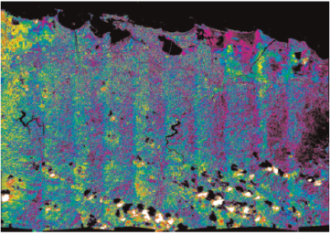
Objectives
Use of high resolution airborne data:
Derive an updated LCLU classification on the LA region: determination of albedo and biophysical parameters of the bare soil (Comarazamy et al. 2010)
Use this data to update the atmospheric model (WRF) urban surface parameters.
Validate the new land surface model and assess its suitability for long-term runs
Understanding local and regional thermal gradients: with emphasis on daily sea breeze – land breeze cycle.
ATLAS-derived albedo dataset used to configure the atmospheric model surface characteristics in San Juan, Puerto Rico (Comarazamy et al. 2010)

Slide 7
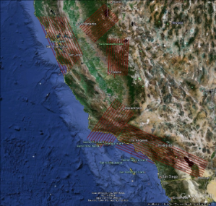
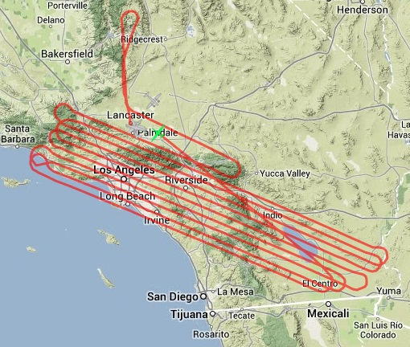
HyspIRI Mission
HyspIRI is a global mission, measuring land and shallow aquatic habitats at 60 meters and deep oceans at 1 km every 5 days (TIR) and every 19 days (VSWIR).
HyspIRI’s VSWIR (Visible Short Wave Infrared)
HyspIRI’s TIR (Thermal Infrared)
HyspIRI Preparatory Airborne Campaign
Flights in California in 2013 and 2014 along 3 transects from capturing ecological/climatic gradients
Plan to fly these 3 transects 3 times per year for the two years; 3-year awards solicited
Flight over Southern California.
September 24th, 2013

Slide 8
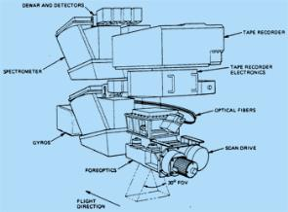
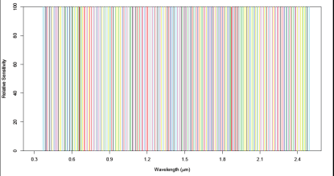
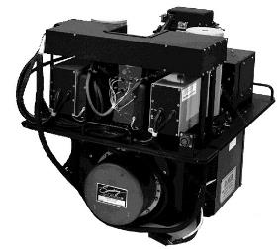
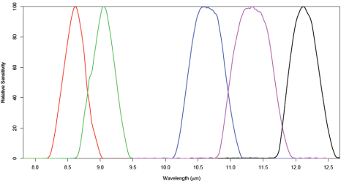
HyspIRI Flightovers Sensors
Airborne Visible/Infrared Imaging Spectrometer (AVIRIS)
Pixel Resolution: 15 m
Spectral resolution: 224 bands from 380 to 2500 nm (Visible/NIR)
MODIS/ASTER Airborne Simulator (MASTER)
Pixel Resolution: 35 m
Spectral resolution: 5 bands between 8 and 12.5 μm (TIR)

Slide 9
Data Processing

Slide 10
Overall Process Flow
Calculation of Broadband albedo (AVIRIS)
Georeference land surface temperature and emissivity (MASTER)
Update surface characteristics in WRF
New Land Surface Model
Offset Correction
Mosaicking
Generation of new/updated land classes
Analysis of subregions
Masking
Resample to 1km and layer stacking
Subseting
Broadband albedo
Land Surface Temperature (LST)

Slide 11
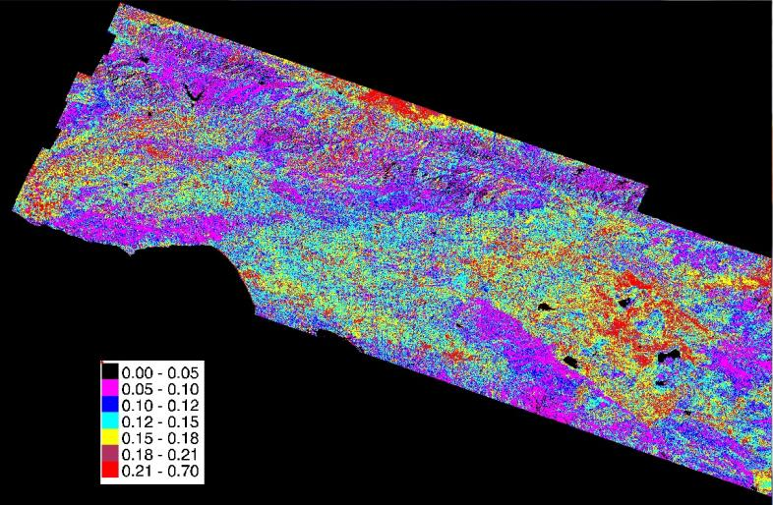
Mosaicking, Masking, Subsetting and Resampling (Albedo)
Broadband map after mosaicking, masking and subsetting (resolution 15 m)

Slide 12
Mosaicking, Masking, Subsetting and Resampling (LST)
LST at approximately 1200 LT map (resolution 35 m). Temperature in ˚C
Temperature differences as high as 30 ˚C between land and sea

Slide 13
Analysis of Urban Land Covers

Slide 14
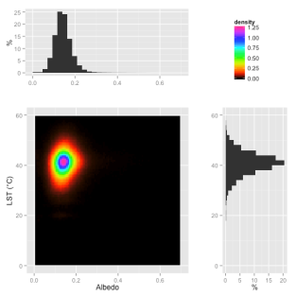
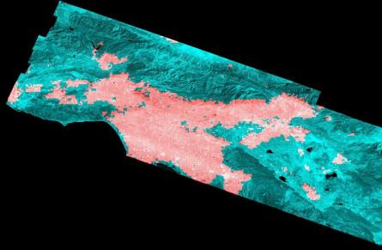
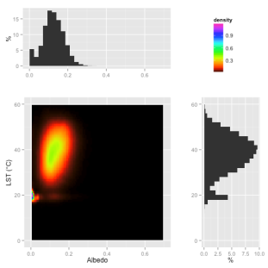
Albedo vs LSTs Densities
Larger range of albedos and LSTs for all classes
Water reflected in low albedo and LST
Highest density located approximately at albedos 0.14 and LSTs of 40 ˚C
Urban Only classes
Urban LCLUs according to MODIS IGBP LCLU scheme (in red)
Non-Urban Only classes

Slide 15
Urban LCLU Classification
The new urban classes were determined by use of the CLARA algorithm on albedos and emissivities and the best number of classes was assessed by using the average silhouette criterion.
The CLARA (Clustering for Large Applications) algorithm extents the k-medoids approach for a large number of objects by clustering a sample from the dataset and then assigning all objects in the dataset to these clusters (Kaufman and Rousseeuw, 1990).
The silhouette width is a measure of dissimilarity between one point and all other points of the same cluster. Observations with a large s(i) (almost 1) are very well clustered, a small s(i) (around 0) means that the observation lies between two clusters, and observations with a negative s(i) are probably placed in the wrong cluster.
Number of Classes | Average Silhouette
3 | 0.47
4 | 0.49
5 | 0.54
6 | 0.52
7 | 0.51
8 | 0.51
9 | 0.50
The optimum number of classes is 5 according to the average silhouette

Slide 16
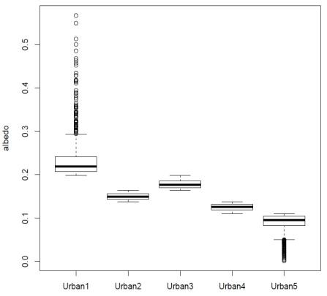
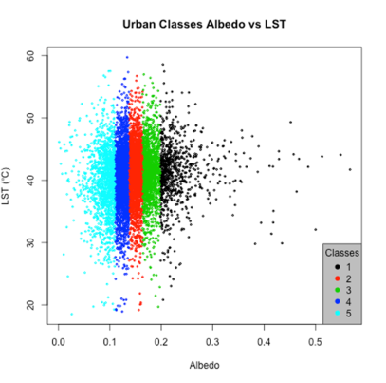
Urban LCLU Classification (New Classes Specifications)
Category name | Category Number in MODIS IGBP scheme | Albedo range
Urban 1 | 21 | 0.20 – 0.57
Urban 2 | 22 | 0.14 – 0.16
Urban 3 | 23 | 0.16 – 0.20
Urban 4 | 24 | 0.11 – 0.14
Urban 5 | 25 | Less than 0.11

Slide 17
Land Surface Models Specifications
Default LSM
Updated LSM

Slide 18
WRF Validation

Slide 19
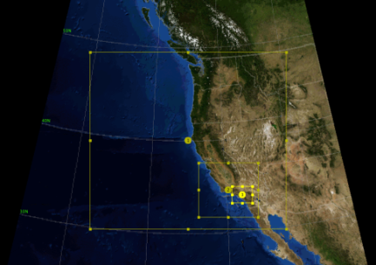
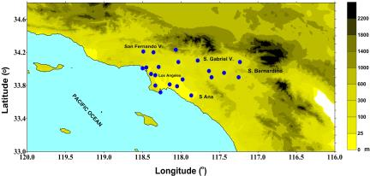
Atmospheric Model (WRF) Setup for Validation
Three two-way nested domains with a grid spacing of 16, 4 and 1 km are defined on a Lambert Conformal Projection.
Initial and boundary conditions from North American Regional Reanalysis (NARR, resolution 32 km)
PBL Parameterization: MYNN 2.5 level TKE.
Radiation Schemes: RRTM and Dudhia scheme.
Unified Noah land-surface model.
Landuse categories : (20 ) from MODIS IGBP plus 5 new urban classes.
Nested Domains
18 surface meteorological stations (in blue), which provide hourly: temperature, wind speed, wind direction and sea-level pressure.

Slide 20
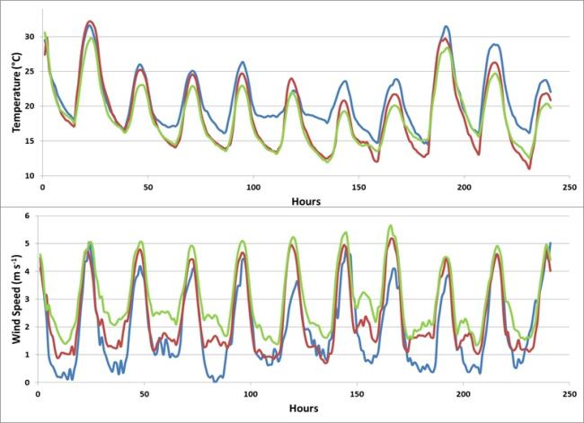
WRF Model Validation: Surface Variables With Different LCLUs September 16-26, 2013
Observations
WRF_updated LSM
WRF_default LSM
WRF with updated LSM improves estimation for both, Temperature and wind speed
WRF with default LSM consistently underestimates temperature and wind speeds.

Slide 21
SoCal Modeled Sea Breeze – Land Breeze Cycle for September 24th 2013

Slide 22
Conclusions and Future Work
The model with the new LSM improves in terms of daytime temperature and wind speeds and captures the regional spatial and temporal pattern of the sea breeze daily cycle.
Integration of all hypotheses in a single numerical experiment in order to solve the question of the most influential individual and/or combined interaction factors on coastal-California temperature trends.
Developing a methodology for other coastal-cooling regions in a global warming setting including updated surface characteristics by use of remote sensing, ground station observational analysis and atmospheric modeling for past, present and future trends. (Peru, Chile, Western South Africa, Abu Dhabi).

Slide 23
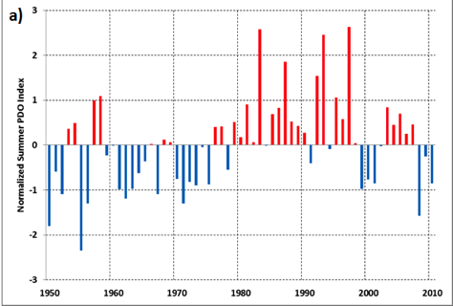
Ensemble for Simulations (Stein and Alpert Method)
Simulation | LCLU | Atmospheric Conditions
f₀ | Past | Past
f₁ | Past | Present
f₂ | Present | Past
f₁₂ | Present | Present
Past
PDO (+)
1980-4
Present
PDO (-)
2009-13
Where: Changes due to LCLU: f₂ - f₀
Changes due to Large scale forcing: f₁ - f₀
Changes due to Both factors: f₁₂ – (f₁ + f₂)+ f₀
Runs will be performed from Jun. to Sep. for each selected year

Slide 24
References
Alfaro, E., A. Gershunov, D. Cayan, A. Steinemann, D. Pierce, and T. Barnett, 2004: A Method for Prediction of California Summer Air Surface Temperature. Eos Trans. AGU, 85, 553-564.
Bakun, A., 1990: Global climate change and intensification of coastal ocean upwelling. Science, 247, 198–201.
Blumenthal, D. L., T. B. Smith, D. E. Lehrman, R. A. Rasmussen, G. Z. Whitten, and R. A. Bazter, 1985: Southern San Joaquin Valley ozone study. Sonoma Technology Inc. Final Rep., 143 pp.
Bonfils, C., and D. Lobell, 2007: Empirical evidence for a recent slowdown in irrigation-induced cooling. Proc. Natl. Acad. Sci., doi:10..1073/pnas.0700144104.
Bornstein, R. D., A. T. Ghebreegziabher, Menne, Jr., M.N., Gonzalez, J. and B. Lebassi, 2013: A case study on the impact of homogenizing monthly temperature series along coastal California. Proceedings 25th Conference on Climate Variability and Change, Austin, TX, American Meteorological Society.
Cayan, D. R., E. P. Maurer, M. D. Dettinger, M. Tyree, and K. Hayhoe, 2008: Climate Change Scenarios for the California Region. Climatic Change, published online, doi:10.1007/s10584-007-9377-6
Chase, T. N, R. A. Pielke, Sr., T. G. F Kittel, R. R. Nemani, and S. W. Running, 2000: Simulated impacts of historical land cover changes on global climate in northern winter. Clim. Dyn., 16, 93–105.
Carr, R. W., and L. Allen, 2001: 2001 Clean Air Plan San Luis Obispo County. Air Pollution Control District County of San Luis Obispo [Available at http://www.slocleanair.org/business/regulations.php]
Chenillat, F., P. Rivière, X. Capet, E. Di Lorenzo, and B. Blanke, 2012: North Pacific Gyre Oscillation modulates seasonal timing and ecosystem functioning in the California Current upwelling system, Geophys. Res. Lett., 39, L01606,doi:10.1029/ 2011GL049966.
Chhak, K., and E. Di Lorenzo, 2007: Decadal variations in the California Current upwelling cells, Geophys. Res. Lett., 34, L14604, doi:10.1029/2007GL030203.
Christy, J. R., W. B. Norris, K. Redmond, and K. P. Gallo, 2006: Methodology and results of calculating Central California surface temperature trends: Evidence of human-induced climate change? J. Climate, 19, 548–563
Clark, R., 2010: CA climate change is caused by the Pacific Decadal Oscillation, not by Carbon Dioxide. Science and Public Policy Institute, September 16, 2010.
Cordero, E.C., W. Kessomkiat, J. Abatzoglou, and S.A. Mauget, 2011: The identification of distinct patterns in California temperature trends, Climate Change, 108, pp. 357-382.
Di Lorenzo, Emanuele, Arthur J. Miller, Niklas Schneider, James C. McWilliams, 2005: The Warming of the California Current System: Dynamics and Ecosystem Implications. J. Phys. Oceanogr., 35, 336–362.
Douville, H., 2003: Assessing the influence of soil moisture on seasonal climate variability with AGCMs, J. Hydrometeorol., 4, 1044-1066.
Duffy, P. B., C. Bonfils, and D. Lobell, 2007: Interpreting recent temperature trends in California. Eos Trans. AGU, 88, 409-410
Falvey, M. and R, Garreaud, 2009: Regional cooling in a warming world: Recent temperature trends in the SE Pacific and along the west coast of subtropical South America (1979-2006). J. Geophys. Res., 114, D04102, doi: 10.1029/2008JD010519.

Slide 25
References
Falvey, M. and R, Garreaud, 2009: Regional cooling in a warming world: Recent temperature trends in the SE Pacific and along the west coast of subtropical South America (1979-2006). J. Geophys. Res., 114, D04102, doi: 10.1029/2008JD010519.
Franco, G., and Sanstad, A., 2008, Climate Change and Electricity Demand in California, Clim. Change, 87 (Suppl.1), pp. S139-S151.
Franks , S. W., 2002, Identification of a chane in climate state using regional flood data, Hydrology and Earth System Sciences, 6(1), 11-16.
Ghebreegziabher, A., 2013: Trends in Surface 1970-2010 Southern California Maximum Temperatures: Extremes and heat waves. M.S. Thesis, Dept. of Meteorology and Climate Science, San Jose State University, 55 pp.
Giorgis, R.B., 1983: Meteorological influence on oxidant distribution and transport in the Sacaramento Valley. Ph.D thesis, University of California at Davis, 124 pp.
Goodridge, J. D., 1991: Urban bias influence on long-term California air temperature trends. Atmos. Environ., 26B.
Gutierrez, D., I. Bouloubassi, A. Siffedine, S. Purca, K. Goubanova, M. Graco, D. Field, L. Mejanelle, F. Velazco, A. Lorre, R. Salvateci, D. Quispe, G. Vargas, B. Dewitte, and L. Ortlieb, 2011: Coastal cooling and increased productivity in the main upwelling zone off Peru since the mid-twentieth century. Geophys. Res. Lett., 38, L07603, doi:10.1029/2010GL046324.
Hayes, T. P., J. J. R. Kinney, and N. J. M. Wheeler, 1984: California surface wind climatology. California Air Resources Boards, Aerometric Projects and Laboratory Branch, Meteorology Section, Sacramento, California, USA.
Karl, T. R., P. D. Jones, R. W. Knight, G. Kukla, N. Plummer, V. Razuvayev, K. P. Gallo, J. Lindseay, R. J. Charlson, and T. C. Peterson, 1993: A new perspective on recent global warming: Asymmetric trends of daily maximum temperature. Bull. Am. Meteor. Soc., 74, 1007–1023.
LaDochy, S., J. Brown, W. Patzert and M. Selke, 2004: Can U.S. west coast climate be forecast? Preprint CD-ROM, Symposium on ‘Forecasting the Weather and Climate of the Atmosphere and Ocean’, Amer. Meteor. Soc., Jan. 11-14, Seattle, WA.
LaDochy, S., R. Medina, and W. Patzert, 2007: Recent California climate variability: spatial and temporal patterns in temperature trends. Climate Research, CR 33, 159–169.
Latif, M. and T. P. Barnett, 1994: Causes of decadal variability over the North Pacific and North America. Science 266, 634-637.
Latif, M., and Barnett, T. P., 1996: Decadal climate variability over the North Pacific and North America: Dynamics and predictability. Journal of Climate, 9, 2407-2423.
Lebassi, B. H., González, J. E., Fabris, D., Maurer, E., Miller, N. L., Milesi, C., and Bornstein, R., 2009, Observed 1970–2005 Cooling of Summer Daytime Temperatures in Coastal California, J. Climate, 22, pp. 3558–3573.
Lebassi, B., J. JE. Gonzalez, R. Bornstein, and, D. Fabris, 2010: Regional impacts in the coastal California environment from a changing climate. J. Solar Energy Engineering, 123, DOI: 10.1115/1.4001564.
Lobell, D. B., C. J. Bonfils, L. M. Kueppers, and M. A. Snyder, 2008: Irrigation cooling effect on temperature and heat index extremes, Geophys. Res. Lett., 35, L09705, doi:10.1029/2008GL034145.
Mann, H. B. and D. R., 1947: On a Test of Whether one of Two Random Variables is Stochastically Larger than the Other. Annals of Mathematical Statistics 18 (1): 50–60.

Slide 26
References
Mantua, N. J. and S. R. Hare, Y. Zhang, J. M. Wallace, and R. C. Francis, 1997: A Pacific interdecadal climate oscillation with impacts on salmon production. Bull. Amer. Meteor. Soc., 78, 1069-1079.
Mauget, S. A., E. C. Cordero and P. T. Brown, 2011: Evaluating Modeled Intra- to Multidecadal Climate Variability Using Running Mann-Whitney Z Statistics. Journal of Climate, 25, 1570-1586.
Maurer, E.P., L. Brekke, T. Pruitt, and P.B. Duffy, 2007. Fine-resolution climate projections enhace regional climate change impact studies. Eos. Trans. AGU, 88 (47), 504.
McGregor, H. V., M. Dima, H. W. Fischer, S. Mulitzal, 2007: Rapid 20th-Century Increase in Coastal Upwelling off Northwest Africa. Science, 315, 637–639.
Menne, Jr., M. J., C. N. Williams, and R. S. Vose, 2009: The US historical climatology network monthly data, version 2. Bull. Amer. Meteor. Soc., 10, 993-1007.
Menne, Jr., M.N., R. D. Bornstein, A. T. Ghebreegziabher, and J. Gonzalez, 2012: A case study on the impact of homogenizing monthly temperature series along coastal California. Proceedings Fall Meeting, San Francisco, CA, American Geophysical Union, [Available at http://fallmeeting.agu.org/2012/eposters/eposter/a43b-0135/]
Miller, N. L., and N. J. Schlegel, 2006: Climate change projected fire weather sensitivity: California Santa Ana wind occurrence. Geophys. Ress. Lett., 33, L15711.
Minobe, S., 1997: A 50–70 year climatic oscillation over the North Pacific and North America. Geophys. Ress. Lett., 24, 683-686.
Minobe, S., 2000: Spatio-temporal structure of the pentadecadal variability over the North Pacific. Prog. Oceanogr., 47, 381–408.
Mintz, Y., 1984: The sensitivity of numerically simulated climates to land-surface boundary conditions. In The Global Climate, Houghton, J., Cambridge Univ. Press, 79–105.
Nemani, R. R., M. A. White, D. R. Cayan, G. V. Jones, S. W. Running, and J. C. Coughlan, 2001: Asymmetric warming over coastal California and its impact on the premium wine industry. Climate Research, 19, 25–34.
Papineau, J. M., 2001: Wintertime temperature anomalies in Alaska correlated with ENSO and PDO. International Journal of Climatology, 21, 1577-1592.
Pielke Sr., R. A., G. Marland, R. A. Betts, T. N. Chase, J. L. Eastman, J. O Niles, D. Niyogi, and S. Running, 2002: The influence of land-use change and landscape dynamics on the climate system: relevance to climate-change policy beyond the radiative effect of greenhouse gases. Philosophical Trans. of Royal Soc. of London-A, 360, 1705–1717.
Root, H. E., 1960: San Francisco, the air conditioned city. Weatherwise, 13, 47-54.
Seaman, N. L., D. R. Stauffer, and A. M. Lario-Gibbs, 1995: A multiscale four-dimensional data assimilation system applied in the San Joaquin Valley during SARMAP. Part I: modeling design and basic performance characteristics. J. Appl. Meteor., 34, 1739-171.
Seo, H., K. H. Brink, C. E. Dorman, D. Koracin, and C. A. Edwards , 2012: What determines the spatial pattern in summer upwelling trends on the U.S. West Coast?, J. Geophys. Res., 117, C08012, doi:10.1029/2012JC008016.
Sequera, P., O. Rhone, J.E. González, R. Bornstein, and B. Lebassi, 2011: Impacts of Climate Changes in the Northern Pacific Coast on Related Regional Scale Energy Demands. 2011 ASME International Conference on Energy Sustainability, August 7-10, 2011, Washington DC, Paper No. ESFuelCell2011-54708.

Slide 27
References
Sequera, P., Y. Molina, R. Bornstein and J.E. González, 2013: Energy Demand Projections in California in the 21st Century: Journal of Solar Energy Engineering, submitted.
Snyder, M. A. et al., 2003:Future climate change and upwelling in the California Current. Geophys. Res. Lett., 30, 1823, doi:10.1029/2003GL017647.
Trenberth, K. E. and J. W. Hurrell, 1994: Decadal atmosphere-ocean variations in the Pacific. Clim. Dynamics, 9, 303-319.
Walters, J. T., R. T. McNider, X. Shi, W. B Norris, and J. R. Christy 2007: Positive sur-face temperature feedback in the stable nocturnal boundary layer. Geophys. Res. Lett., 34, L12709, doi:10.1029/2007GL029505.
Williams, W., and R. DeMandel, 1966: Land-sea Boundary Effects on Small Scale Circulations. SJSU Res. Rep., Meteor. Dept., 97 pp.
Xu, C., T. Chen, W. Li and Y. Chen, 2006: Climate change and hydrologic process response in the Tarim River Basin over the past 50 years. Chinese Science Bulletin. 51 Supp. I, 25-36.
Zhang, H., 1997: Henderson-Sellers, A. & McGuffie, K. Impacts of tropical deforestation. Part II: The role of large scale dynamics. J. Climate, 10, 2498–2522.
Zhang, Y., J. M. Wallace and D. S. Battisti, 1997: ENSO-like Interdecadal Variability. Journal of Climate, 10, 1004-1020.
The City of San Diego City Council, 2008: Final Program Environmental Impact Report (PEIR) [Available at http://www.sandiego.gov/planning/genplan/pdf/peir]

