Slide 1

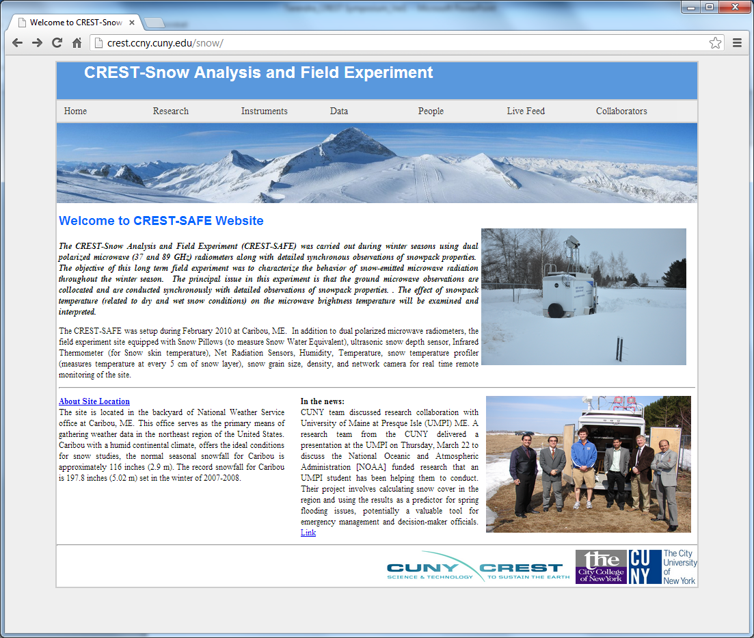
CREST-Snow Analysis and Field Experiment (CREST-SAFE): Continuous In Situ Observations of Snow Physical Properties and Microwave Emission
Tarendra Lakhankar, Jonathan Muñoz, Carlos Perez, Peter Romanov,
Reza Khanbilvardi, Bill Rossow, and Al Powell

Slide 2
Overview
Introduction
Study Area
Instrumentations
Research Objectives
Observations and Analysis
Summary

Slide 3
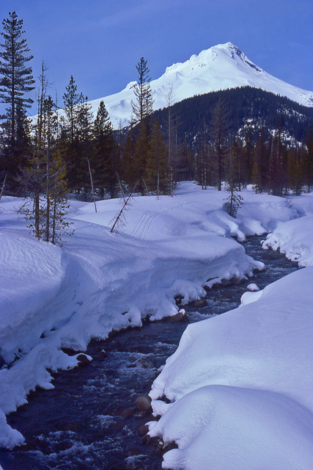

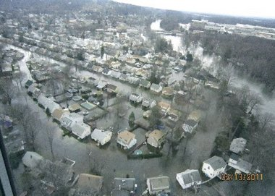
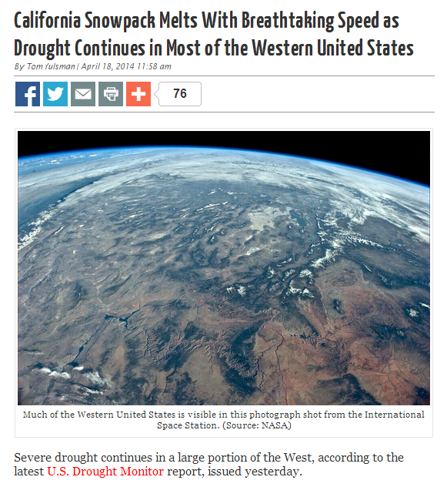
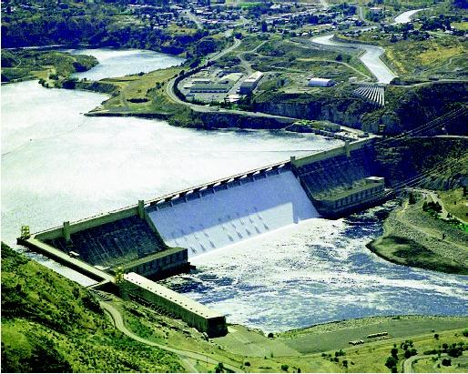
Introduction
Snow is an important factor for:
    Transportation
    Hydro-power generation
    Agriculture
    Wildlife
    Recreation
Seasonal Reservoir
NOAA needs information on snow to:
    Weather Prediction
    Monitor climate change
    Make hydrological forecasts
    Issue flood warnings
March 13, 2011
Man-made Reservoir

Slide 4

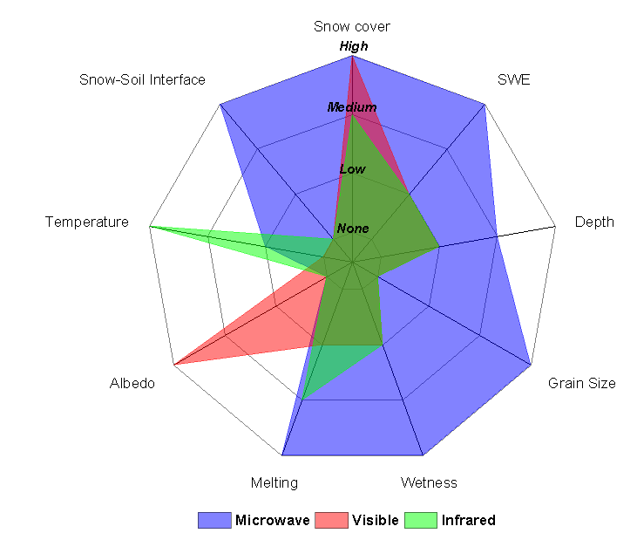
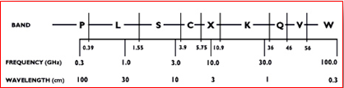
Remote Sensing of Snow
Remote sensors (satellites) observes emissivity which is used to detect snowpack properties by dielectric characteristics.
Upwelling microwave radiation is emitted by the sub-snow surface and altered by the snow pack.
Therefore it carries information on the physical properties of the snow pack.
Spectral range 10-100GHz is most efficient for snow remote sensing
Sensor responses to snowpack properties of interest

Slide 5
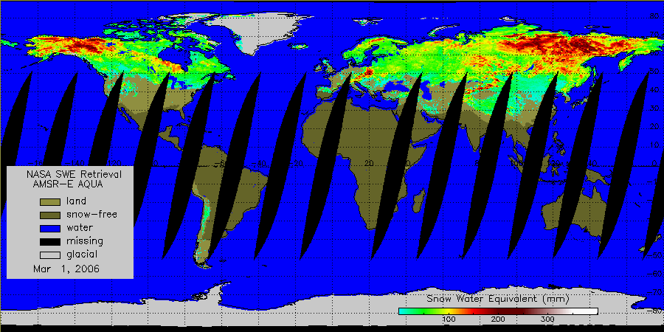
Microwave snow products
AMSR-E Aqua
Snow water equivalent
Daily, 25 km resolution
Snow depth and SWE have been derived since mid-1970s
Microwave snow algorithms
  - Assume fixed snow pack properties (e.g. grain size)
  - Use simplified models of Microwave Radiative transfer in snow pack
As a result:
  Retrieval errors are large (about 100% and more)

Slide 6
CREST-SAFE

Slide 7
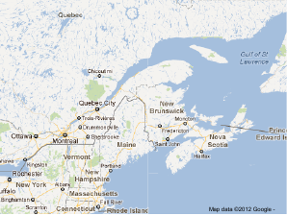
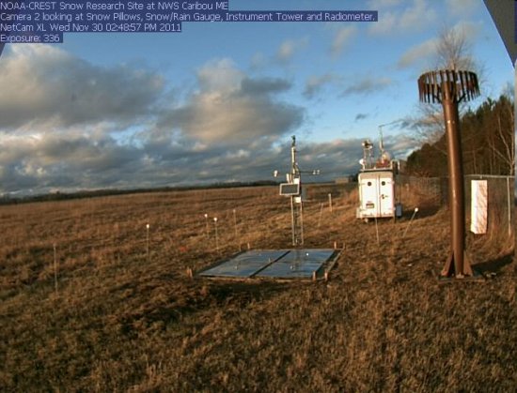
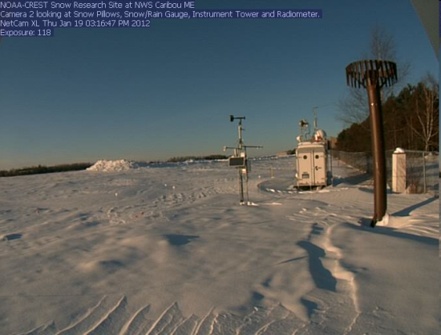
CREST-SAFE Field Research Station at Caribou, ME
Established in 2010 in Caribou, ME
Located on the premises of NWS Regional Forecast Office at Caribou Regional Airport
  Humid continental climate.
  Normal seasonal snowfall for Caribou is approximately 116 inches (2.9 m).
  Record snowfall is 197.8 inches (5.02 m) set in the winter of 2007-2008
Most observations are automated and run 24/7
Routine manual observations started in 2012
Observations include:
Physical properties of snow pack
Meteorological parameters, radiation fluxes
Microwave and thermal emission of snow

Slide 8
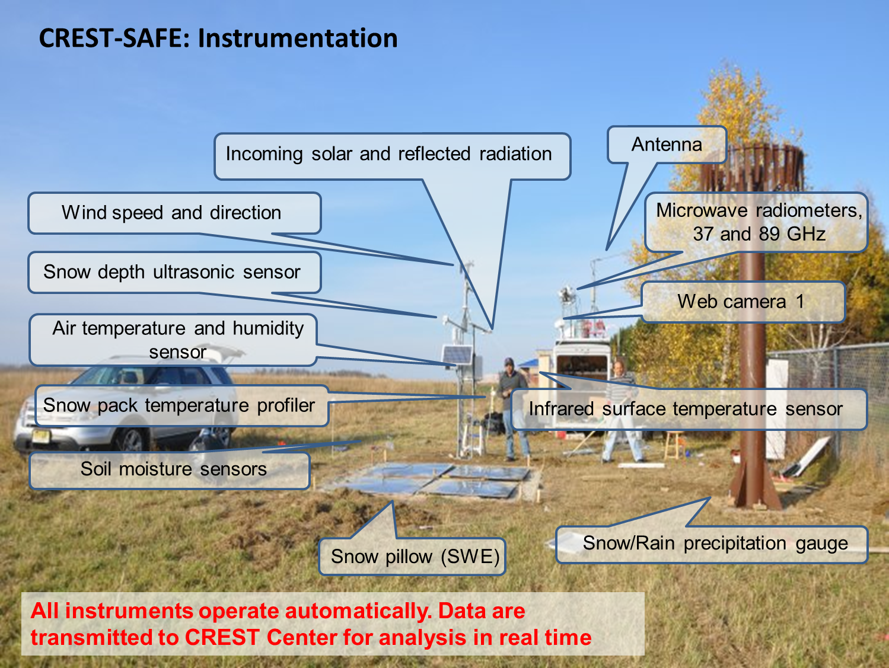
CREST-SAFE - Snow Analysis and Field Experiment
Snow Pillow (SWE)
Rain/Snow Gauge
Soil Moisture (2.5, 5, 10cm)
Soil Temp (2.5, 5, 10cm)
Network Cameras (2)
Infrared Thermometer
(Skin Temperature)
Snow Depth Sensor
Radiation Sensors
Wind Speed/Direction, Humidity/air temperature
DoD / Navy Funding
19 and 10.65 GHz Radiometers
CIMEL Sun Photometer
37 GHz Radiometer
89 GHz Radiometer
Snow Wetness profiler
GMON3 SWE Sensor
Snow Temperature Profiler
2010
2011
2012
2013
2014
Timeline of Snow Experiment Development

Slide 9
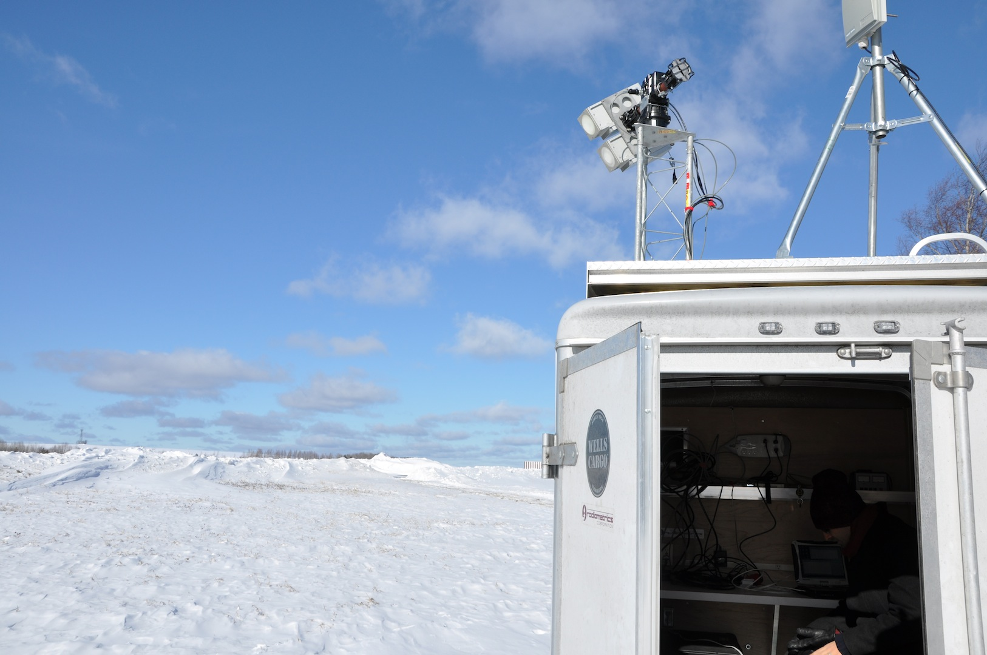
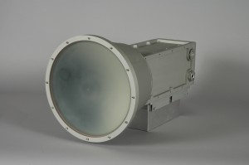
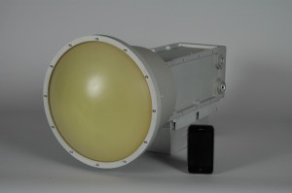
Microwave Radiometers
CREST-SAFE | SSMI | AMSR-E/2 | TMI | WindSAT | GMI (GPM)
 |  | 6.93 VH |  | 6.8 VH
10.65 VH |  | 10.65 VH | 10.7 VH | 10.7 VH | 10.65 VH
19* VH | 19 VH | 18.7 VH | 19.4 VH | 18.7 VH | 18.7 VH
 | 22 V | 23.8 VH | 21.3 V | 23.8 VH | 23.8 V
37 VH | 37 VH | 36.7 VH | 37 VH | 37.0 VH | 36.5 VH
89 VH | 87 VH | 89 VH | 85.5 VH |  | 89.0 VH
Notes:
Hello Everyone.
In this presentation, I will talk about our current Snow field experiment, instrumentations and show you some preliminary results. Here I would like to thank all my colleagues at NOAA-CREST Center Dr. Temimi, Marco Tedesco, and Bill Rossow for their support and advices.
The picture on the first page was taken on site exactly one year during installation. Unfortunately, we didn’t receive any snow in that winter season.

Slide 10
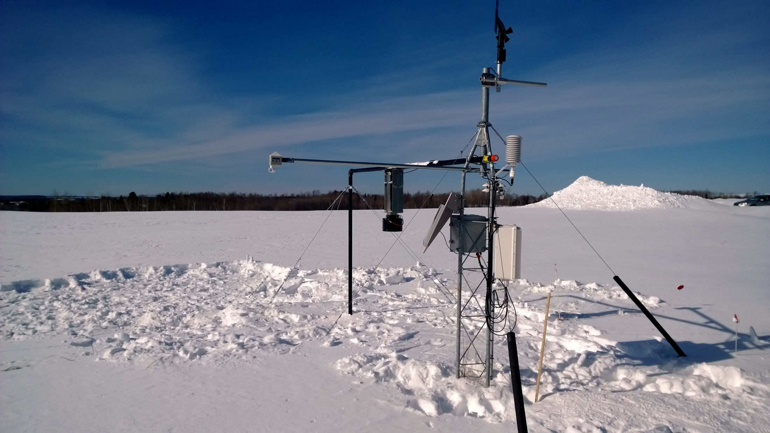
Weather
Air Temperature
Wind Speed
Relative Humidity
Precipitation
Snowpack | Method
Skin Temperature | Thermal Infrared
Snow Depth | Ultrasonic
Radiative Fluxes | Radiation
SWE* | Gamma-Radiation
Weather Parameters from Caribou NWS :
  Cloudiness, snowfall, rainfall, temperature, humidity
* Installed ON February 5th, 2014

Slide 11
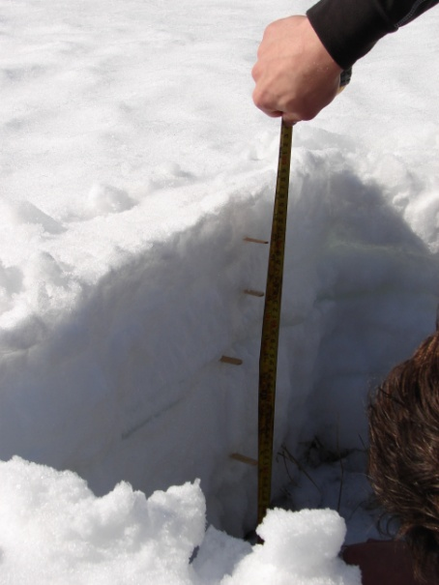
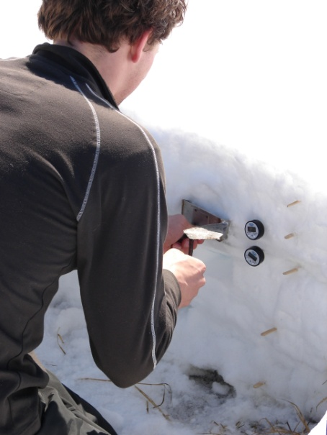
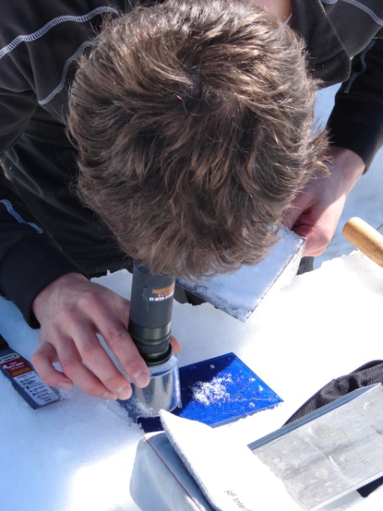
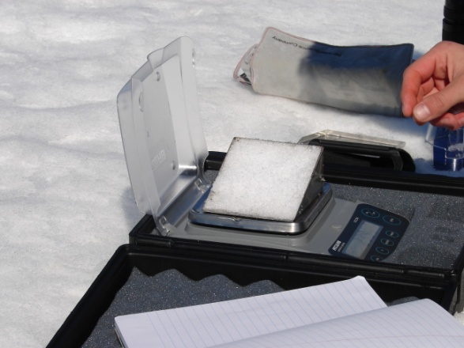
Manual Observations of Snowpack
Started in December 2011
Include:
Snow pit measurements, every 2-3- days
  Vertical profiles of snow density, grain size, hardness,
  Snow depth, snow surface temperature

Slide 12
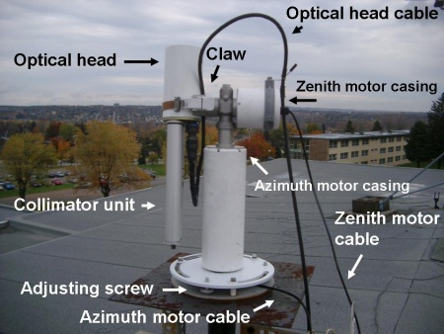
CIMEL Sun-photometer
  A multichannel automated ground and sky-scanning radiometer manufactured by CIMEL Electronique, takes measurements of direct sun, sky-scattered and surface-reflected radiation at pre-determined (0.6 – 1.2 µm) wavelengths in the VIS/IR band.
* To be installed next week.

Slide 13
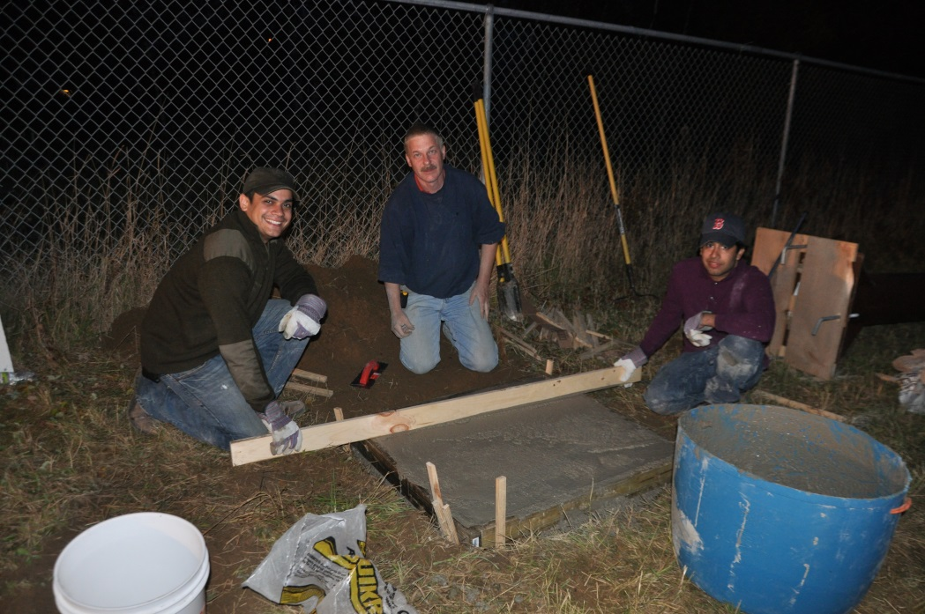
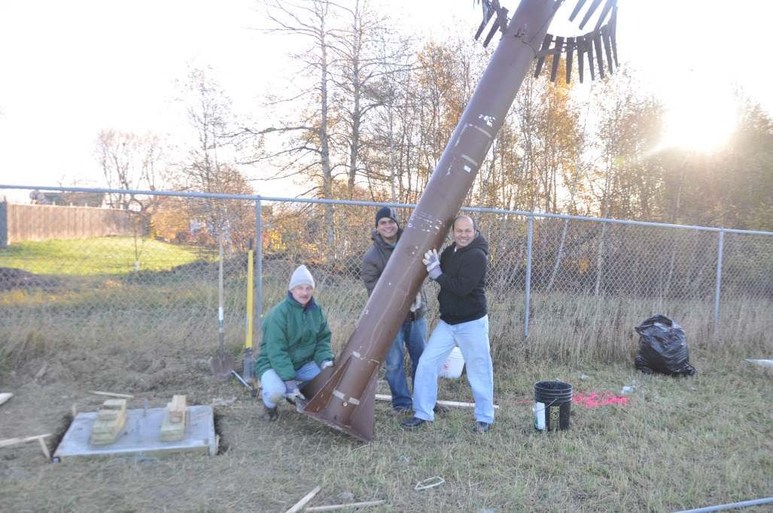
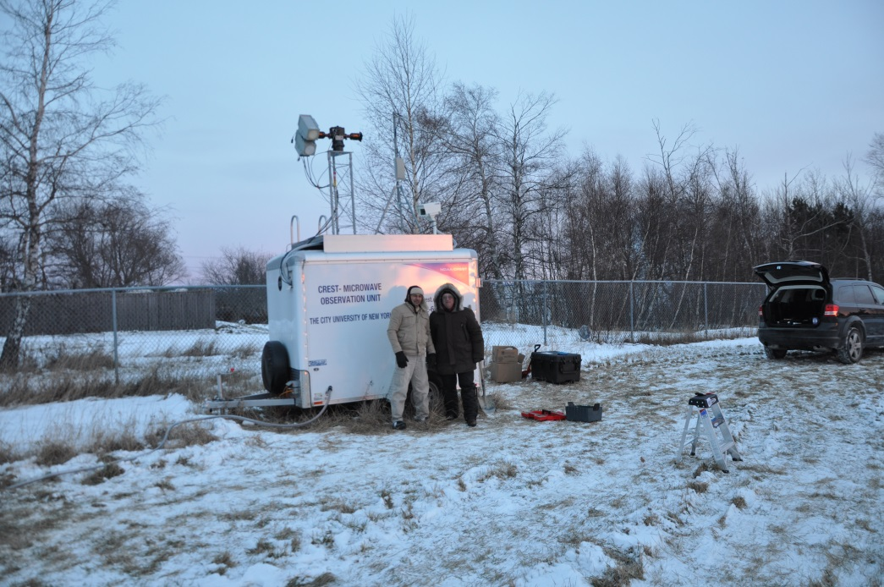
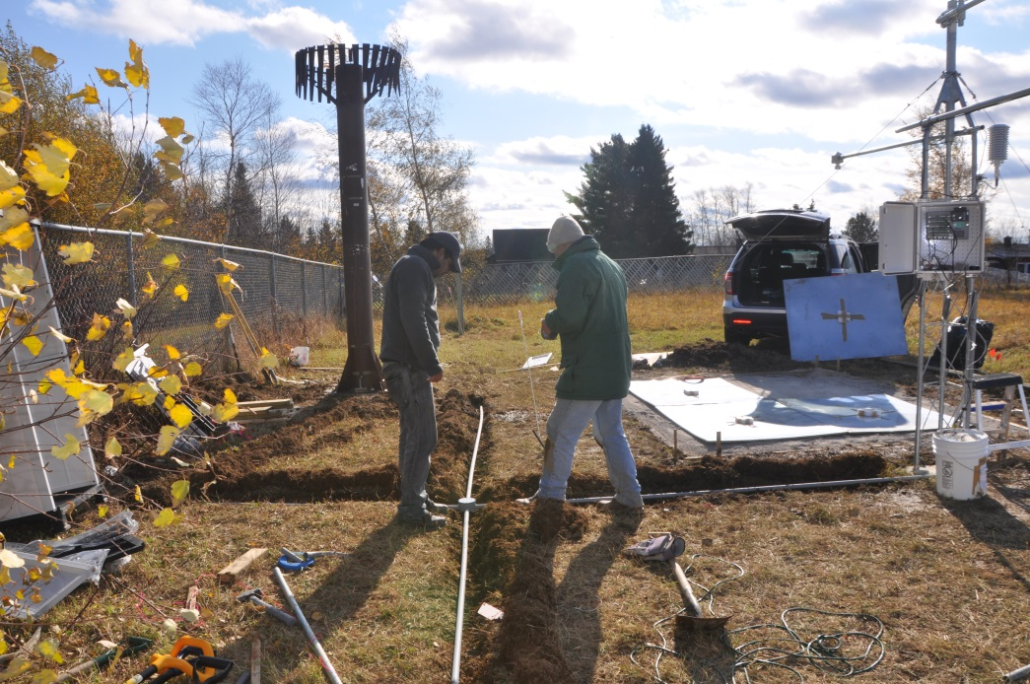
CS650 - Measures dielectric permittivity, and bulk electrical conductivity.

Slide 14
CREST-SAFE: Objectives
Study seasonal changes in the snow pack (density, grain size, etc.)
Study snow microwave emission and its links to snow properties
Test and improve models
  Snow pack physical properties & seasonal change
  Microwave emission from the snow pack
Develop satellite-based snow retrieval techniques
Provide field work training for students
Test new instrumentation for snow research
Satellite retrieval algorithms
Improved satellite snow products
In situ observations
Improved models

Slide 15
Data Availability and Access
The CREST-SAFE experiment uses an integrated multi-source data collection, system. The radiometric data is stored on a computer laptop inside the trailer at the remote location. The data is later transmitted to CREST servers via FTP for preprocessing.
At the present, the data can be assessed in real time from:
http://www.star.nesdis.noaa.gov/smcd/emb/snow/caribou/microwave.html
http://crest.ccny.cuny.edu/snow/

Slide 16
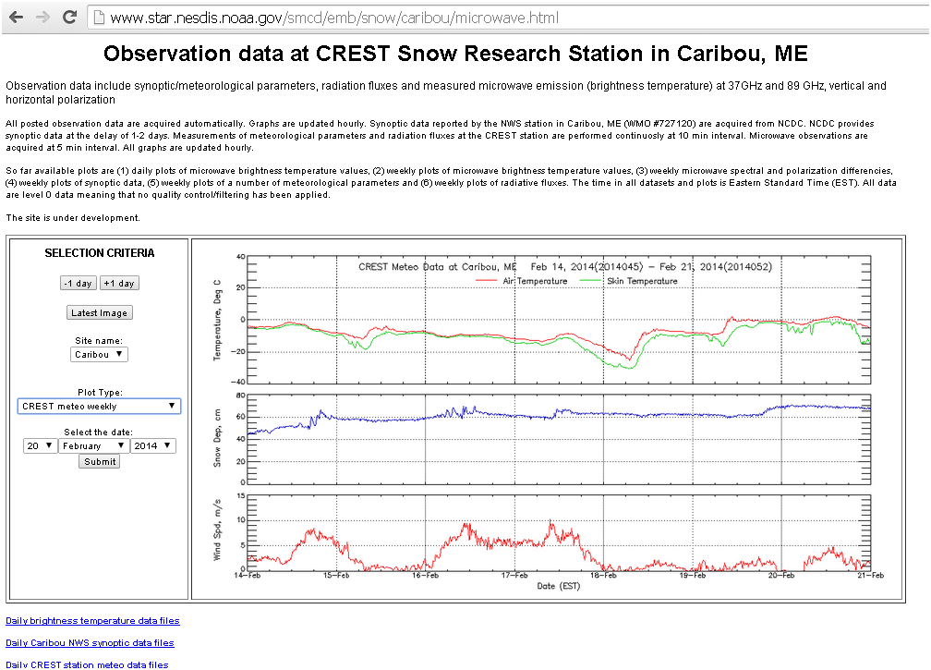
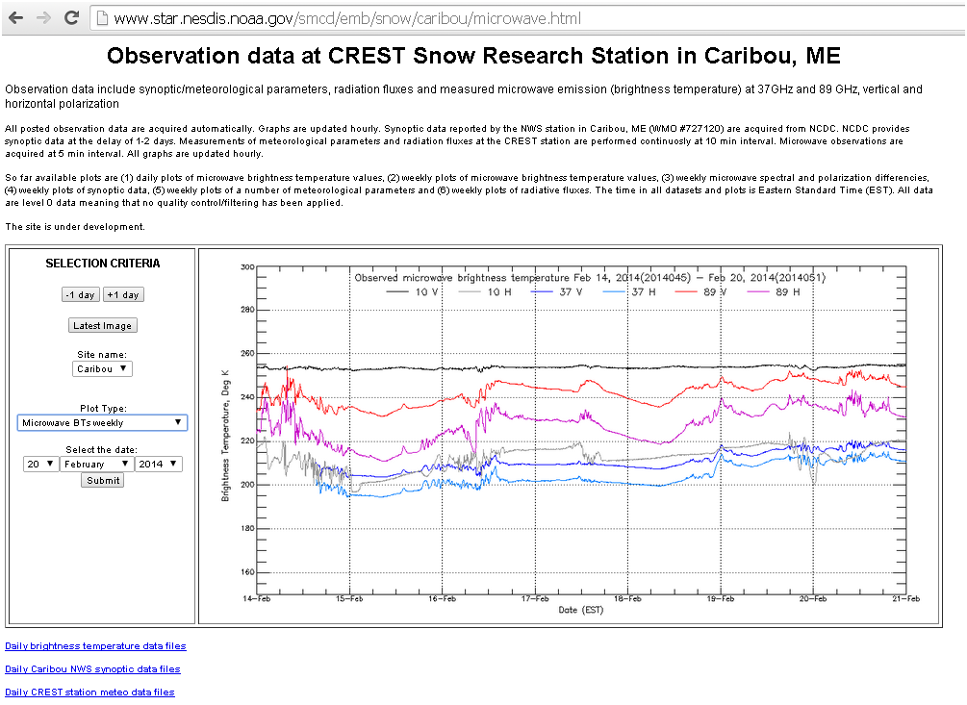

Slide 17
CREST-SAFE
Observations and Analysis

Slide 18
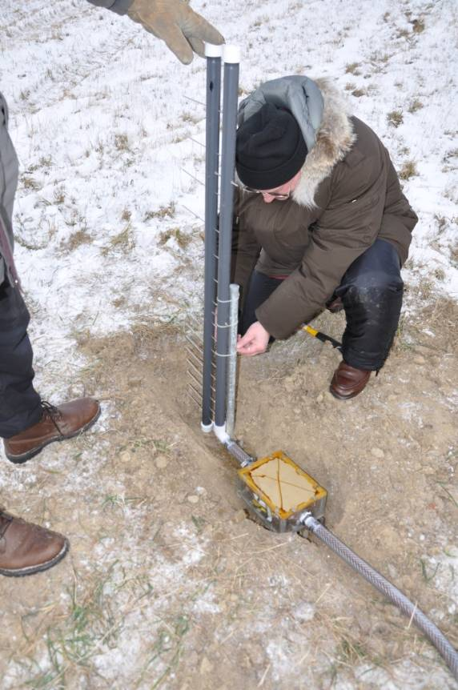
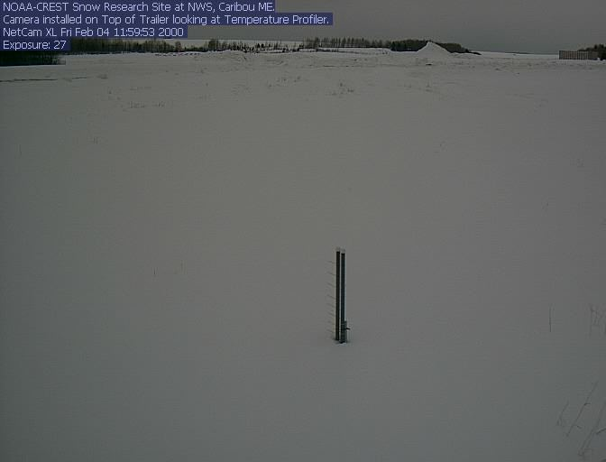
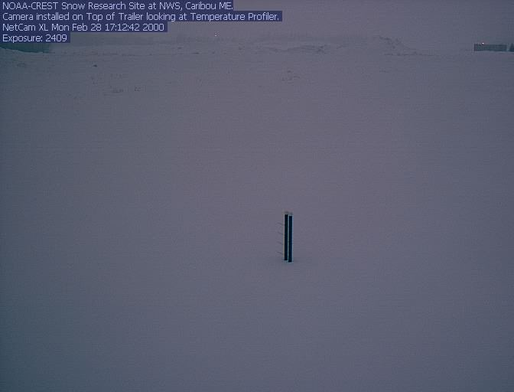
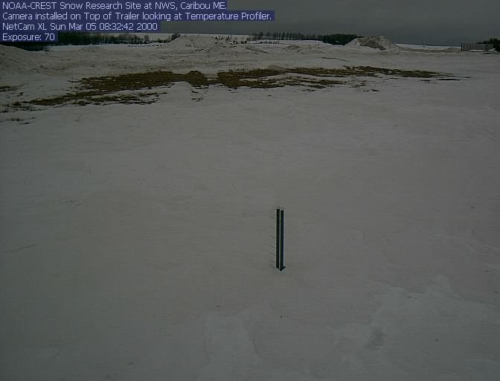
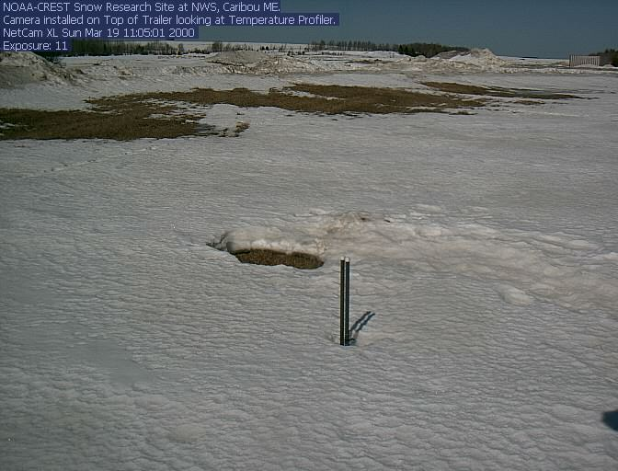
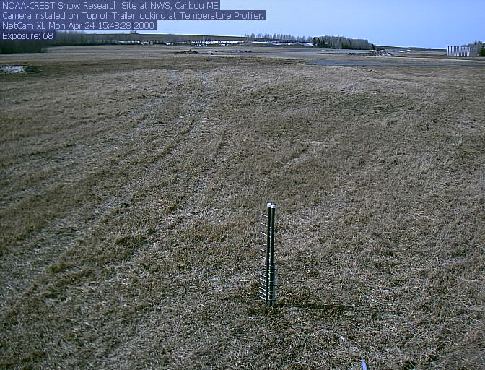
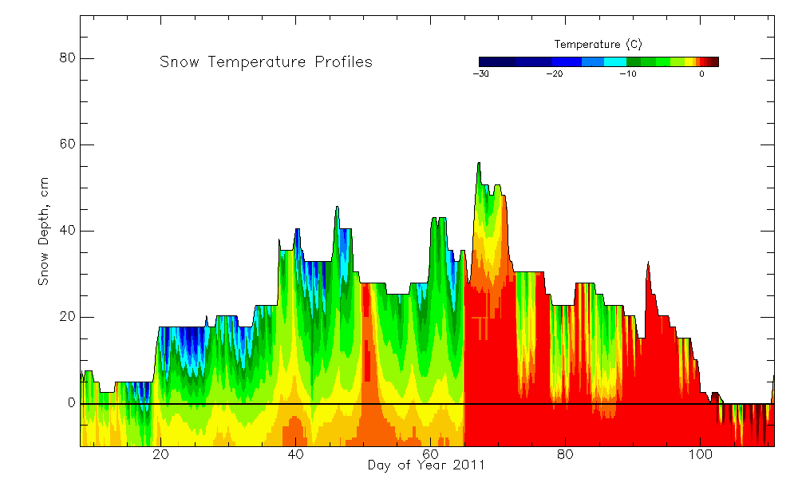
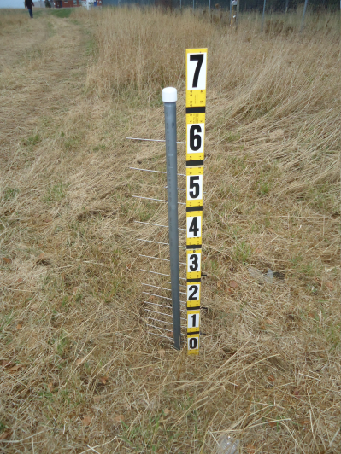
CREST-SAFE: Observations
Snow pack and soil temperature profiler
- Measures temperature at 16 levels
- Down to 10 cm in soil
- Up to 1.0 m in the snow pack
Red color indicates 0⁰C temperature
Observed snow depth and snow temperature profiles in January to March 2011

Slide 19
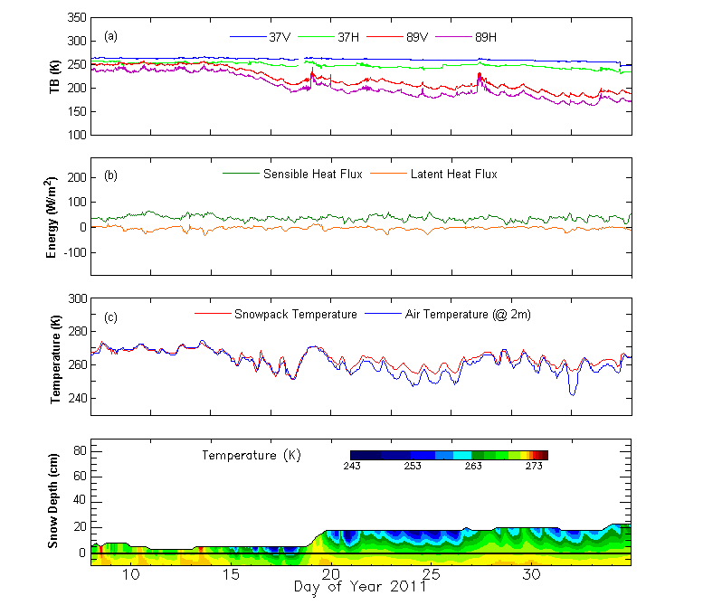
Early Winter Observations
Snow accumulates during snowfall events due to below freezing temperature without snow melts.
The diurnal variation of brightness temperature during this period was expected to be smaller due to slow snow metamorphism compared to mid and late winter period.
Lakhankar, T., Muñoz, J., Romanov, P., Powell, A. M., Krakauer, N. Y., Rossow, W. B., and R. M. Khanbilvardi (2013) CREST-Snow Field Experiment: analysis of snowpack properties using multi-frequency microwave remote sensing data, Hydrology Earth System Science (HESS), 17, 783-793, doi:10.5194/hess-17-783-2013.

Slide 20
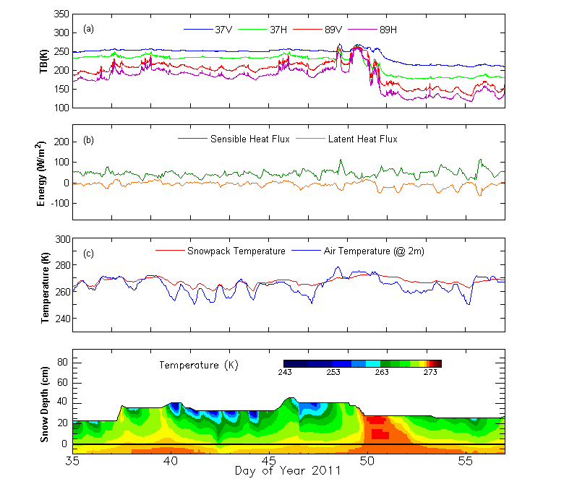
Mid Winter Observations
Similar snow depth and snow pack temperatures, but different microwave brightness temperatures
Other snow pack properties (snow density, grain size, ice layers) are different
Fresh snow
Snow melt
Refrozen snow

Slide 21
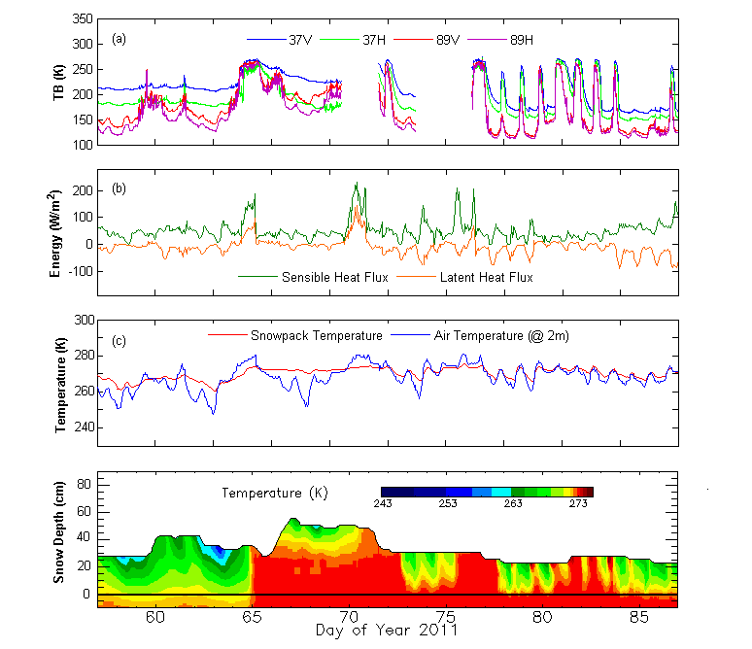
Late Winter-Early Spring Observations
Due warm day and cold night, we observed cycle of melting and refreezing, that causes large variation in brightness temperature during this period.
During melting and refreezing, the trends in 37 and 89 GHz of brightness temperatures were consistent with snowpack temperature
Avalanche ???

Slide 22
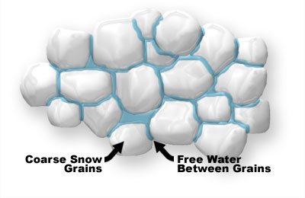
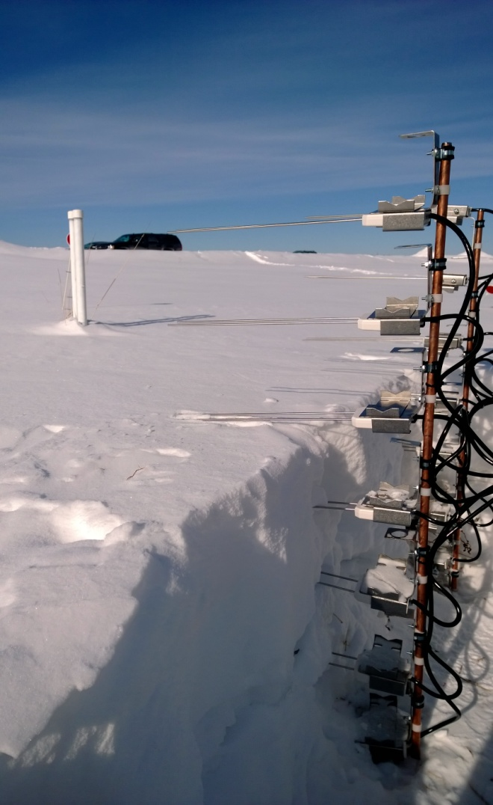
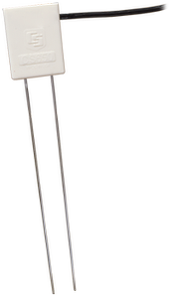
Snow Wetness
Snow wetness is a function of free water in pores of coarse snow grains
Typical Diurnal Variations in Brightness Temperature
Refreezing
Melting
Experimental Set-up for Snow Wetness Profiler
Tb-K
Dry Old Snow
CS650 - Measures dielectric permittivity, and bulk electrical conductivity.
DRY Fresh Snow
12:00
Wet Snow
Time

Slide 23
CREST- SAFE Snow Wetness Profiler
CS650
Water Content
Reflectometer
Dielectric Permittivity
Vertical
Snow Wetness
Profile

Slide 24
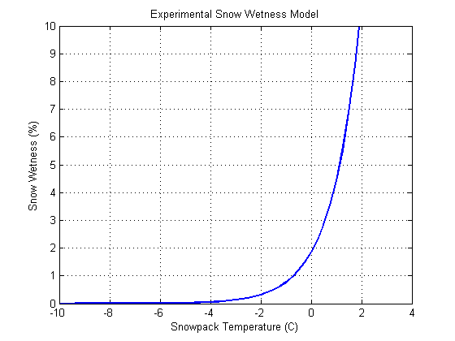
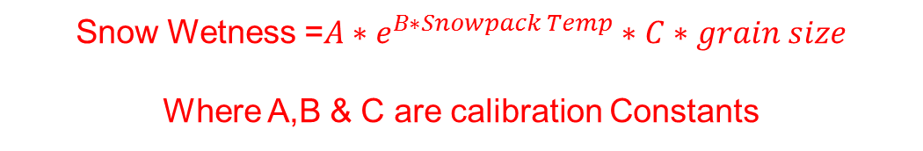
Snow Wetness Model
Based on literature and CREST-SAFE data analysis,
we proposed snow wetness model:
Snow Wetness =${A∗e}^{B∗Snowpack Temp}∗C∗grain size$
Where A,B & C are calibration Constants
The developed snow wetness model uses observed data collected on the CRES-SAFE site to generate a ground physical/empirical model to estimate snow wetness.

Slide 25

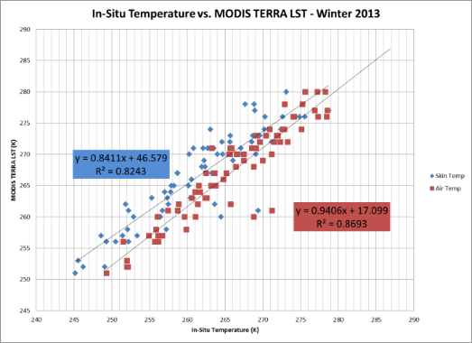
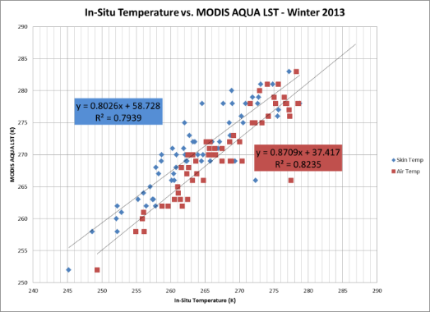
Land Surface Temperature ??
1.5m

Slide 26
Modeling Comparison and validation

Slide 27
Snow Models
The HUT snow emission model is a semi-empirical model based on the radiative transfer theory. The model describes the snowpack as a homogenous layer, using effective values for parameters influencing scatter such as snow depth, density and grain size
Units | Variable
°C | Snow temperature
m | Layer thickness
g/cm3 | Snow density
mm | Snow grain diameter
% | Snow moisture, volumetric
ppm | Snow salinity
The Snow Thermal Model (SNTHERM) is a 1-dimensional model that analyzes the snowpack properties given the climatological conditions of a particular area
Unit | Variable | Source
°K | Air Temperature | NOHRSC, NCDC, NLDAS
m/s | Wind Speed | NCDC
m/s | Precipitation Water Eq. | NOHRSC, NCDC, NLDAS
1=Rain, 2=Snow | Precipitation Type | NOHRSC, NCDC
m | Precipitation Diameter | NCDC
W/m2 | Incoming Solar | NOHRSC, NCDC, NLDAS
Fraction | Reflected solar | NOHRSC, NCDC, NLDAS
W/m2 | Down welling Long Wave | NOHRSC, NCDC, NLDAS
% | Low Cloud Cover | NOHRSC, NLDAS
 | Cloud Type | NOHRSC, NCDC, NLDAS
 | Mid Cloud Cover | NOHRSC, NCDC, NLDAS
 | High Cloud Cover | NOHRSC, NCDC, NLDAS

Slide 28
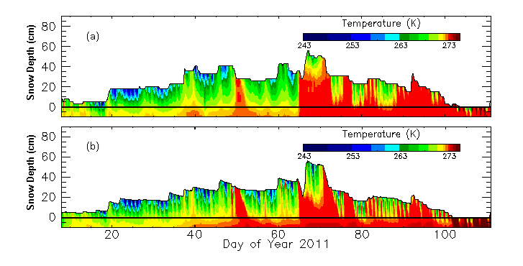
Modeling Studies
SNTHERM model
Input: Meteorological parameters
Output: Physical properties of snow
Output of this model can be used to predict snow microwave emission
Sensor Level (cm) | Correlation Coefficient ( R ) | Mean Absolute Difference ⁰C
T(-10) | 0.813 | 0.695
T(-5) | 0.834 | 0.541
T(0) | 0.847 | 0.744
T(+2) | 0.850 | 1.091
T(+4) | 0.905 | 1.161
T(+6) | 0.910 | 2.050
T(+8) | 0.803 | 1.895
T(+10) | 0.759 | 3.383
T(+12) | 0.733 | 2.636
T(+15) | 0.507 | 2.335
T(+18) | 0.877 | 2.784
T(+21) | 0.881 | 3.595
Comparison of observed temperature with modeled temperature of snowpack at varying snow depth.

Slide 29
Applications – Improvement of Snow Emission Model
NCDC
(Met. Observations)
Satellite Data
(Microwaves)
Satellite Data
(Visible/Infrared/MW)
Observed Data
(Snow Pit)
Data
Acquisition
Krigging
(Gridded Maps)
Brightness
Temperature
Snow Temperature
Grain Size
Snow Temperature
Grain Size
SNTHERM
Model
Snow temperature
Snow Grain size Snow Density
HUT Snow Model
(or Improved CRTM)
Snow Wetness
Snow Wetness Index
Modeling
Cross Validation with CREST-SAFE DATA
Gridded Snowpack
(Daily)
Main Steps
Application
Secondary Steps
Snowpack
(High Resolution)
Avalanche Risk Index
Future Work

Slide 30





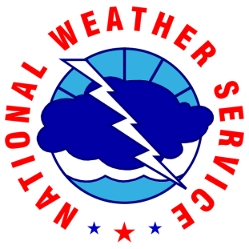
Acknowledgements
Center for Satellite Applications and Research (STAR)
Dr. Alfred M. Powell
NWS WFO Caribou ME
Dr. Peter Rahe
Dr. William Desjardins
Other staff members
City College of New York (CCNY)
Eugene Leykin
University of Maine at Presque Isle
Philip Boody
Prof. David Putnam
Prof. Chunzeng Wang

